Slide 1



School of Information Technology
https://www.monash.edu.my/
FIT5226
Multi-agent System & Collective Behaviour
Week 8: Population Games and Evolutionary Game Theory
FIT5226-S2-2024
Prepared by: Bernd Meyer. Edited by: Fuad Noman
www.monash.edu.au

Slide 2
Acknowledgements
This material includes content adapted from instructional resources made available by the authors of our main textbook, Chapter 6 “Multiagent Systems”, Yoav Shoham and Kevin Leyton-Brown, Cambridge University Press, 2009.

Slide 3
Quiz – Week 9
60 minutes duration
in your normal lab - be one time, no late admissions !!!
closed book + calculator
On Moodle: bring a laptop (and a calculator)
any computer use other than for Moodle will lead to immediate disqualification
All material up to Week 8 (but excluding Week 2)
Multiple choice and numeric answers: state all results with 2 digits of precision
(executing code, calculating properties and results)
lab exercises are a pretty good guide!
Marking will be fully automatic, 1 point per correct answer.
use SLB and “Essentials of Game Theory”

Slide 4
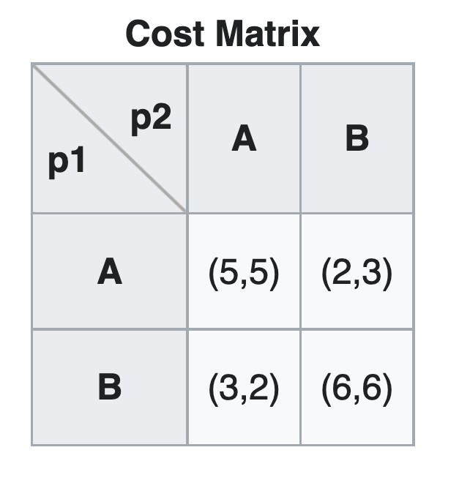
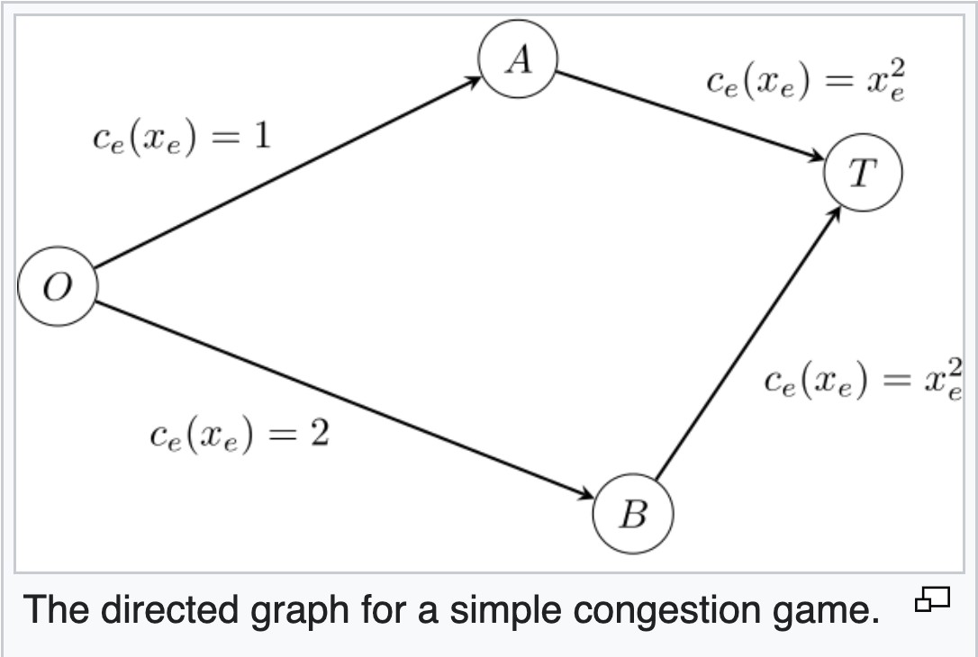
Example: Selfish Routing
Nash=???
https://en.wikipedia.org/wiki/Congestion_game
FIT5226-S2-2024
4/59
Notes:
Consider a traffic net where two players originate at point O and need to get to point T. Suppose that node O is connected to node T via two paths: O-A-T and O-B-T, where A is a little closer than B (i.e. A is more likely to be chosen by each player), as in the picture at the right.
The roads from both connection points to T get easily congested, meaning the more players pass through a point, the greater the delay of each player becomes, so having both players go through the same connection point causes extra delay. Formally, the delay in each of AT and BT when $x$ players go there is $x^{2}$.
Good outcome in this game will be for the two players to "coordinate" and pass through different connection points. Can such outcome be achieved? The following matrix expresses the costs of the players in terms of delays depending on their choices:

Slide 5
Intro: Selfish Routing (Example)
Nash=(A,B); (B,A)
https://en.wikipedia.org/wiki/Congestion_game
FIT5226-S2-2024
5/59

Slide 6
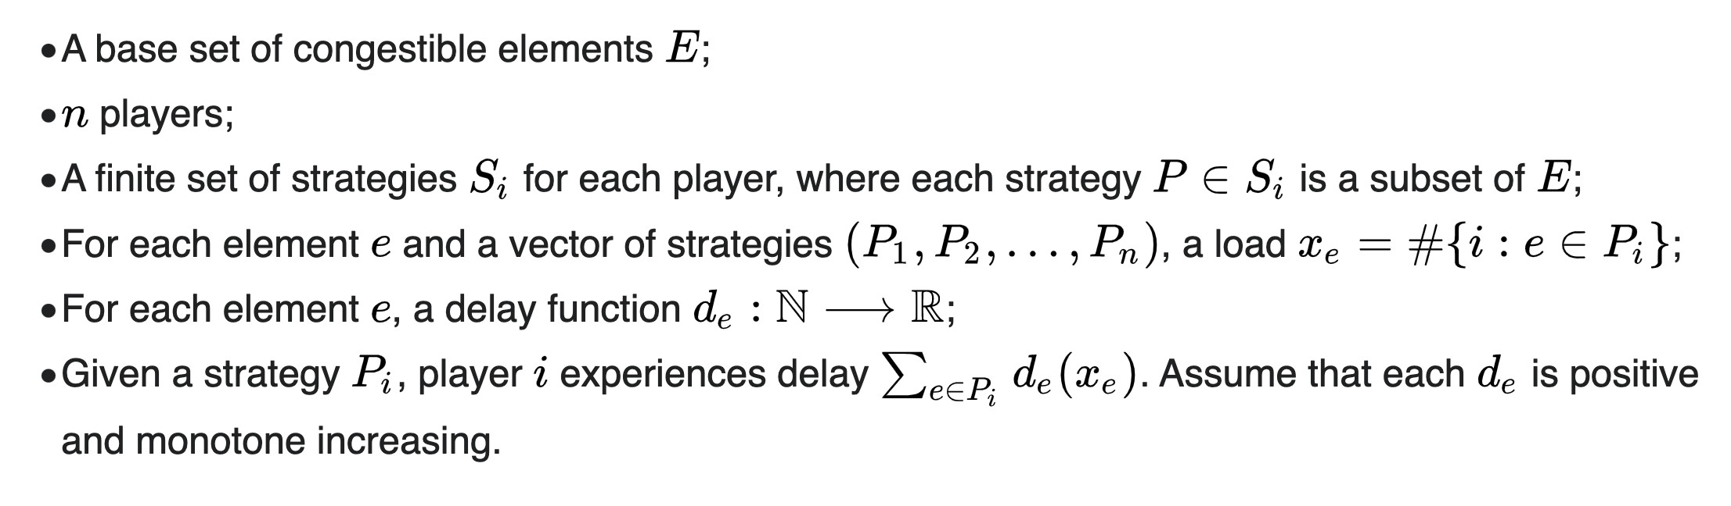
Congestion Games (Def)
Selfish routing is a particular form of a congestion game
https://en.wikipedia.org/wiki/Congestion_game
FIT5226-S2-2024
6/59
Notes:
The basic definition of a CG has the following components.
A base set $E$ of congestible elements (also called resources or factors). In the above example, $E$ is the set of roads ($OA, AT, OB$, and $BT$).
A set of $n$ players. In the above example $n$=2.
A finite set of strategies $S_{i}$ for each player, where each strategy $P∈S_{i}$ is a subset of $E$.
In the above example, both players have the same set of strategies: $S_{1}=S_{2}=\left\{\left\{OA, AT\right\}, \left\{OB, BT\right\}\right\}$. CGs in which all players have the same set of strategies are called symmetric CGs. In general, different players may have different sets, for example, if each player has a different source and/or a different target. Such CGs are called asymmetric CGs.
In general, a strategy can be any subset of $E$. CGs in which a strategy can only be a path in a given graph (as in the above example) are called network CGs. CGs in which a strategy can only be a single resource are called singleton CGs.
For each element $e∈E$ and a vector of strategies $\left(P_{1}, P_{2}, …, P_{n}\right)$, the load is defined as $x_{e}=\#\left\{i:e∈P_{i}\right\}$.
For each element $e∈E$ there is a delay function $d_{e}:ℕ$⟶$ℝ$ (also called latency function or cost function). Given a vector of strategies, the delay on $e$ is $d_{e}\left(x_{e}\right)$. Each $d_{e}$ is assumed to be positive and monotone increasing.
Given a strategy $P_{i}$, player $i$ experiences delay $\sum_{e∈P_{i}}{d_{e}\left(x_{e}\right)}$; each player wants to minimize his delay.
A Nash equilibrium is a vector of strategies $\left(P_{1}, P_{2},…, P_{n}\right)$ such that, for each player $i$, replacing $P_{i}$ with a different strategy $Q_{i}$ would not decrease the delay experienced by $i$.

Slide 7
Population Games
Population games are played in large populations. All players are indistinguishable.
They have the same strategy sets.
It does not matter, who plays which strategy.
Only the proportion of the population playing a particular strategy matters.
Observation: Congestion games are a particular form of population game.
FIT5226-S2-2024
7/59
Notes:
Population games are a class of games that are played in large populations where all players are considered indistinguishable. In these games, each player selects a strategy from the same set of available strategies, and the only aspect that matters is the proportion of the population that chooses each strategy.
Key characteristics of population games include:
Indistinguishable Players: In population games, individual players are treated as indistinguishable entities. This means that there is no distinction between individual players, and the focus is on the aggregate behavior of the population as a whole.
Uniform Strategy Sets: All players in the population have access to the same set of strategies. There is no differentiation in strategy options among individual players.
Proportional Representation: The outcome of the game depends on the proportion of the population that adopts each strategy. It doesn't matter which specific individuals choose which strategy; what matters is the relative frequency of each strategy in the population.
Aggregate Behavior: Population games are concerned with the collective or aggregate behavior of the population. This approach simplifies the analysis by considering how the distribution of strategies changes over time without delving into individual-level interactions.
Regarding your observation, you are correct that congestion games are a specific type of population game. Congestion games are often used to model scenarios where multiple users or agents share limited resources, such as network bandwidth or transportation routes. In congestion games, the strategies represent choices of routes or resources, and the payoff for each player depends on the congestion level of their chosen option, which, in turn, is influenced by the choices made by the entire population.
Overall, population games are a valuable framework for studying situations where individual interactions are too numerous to analyze on an individual basis, and instead, the focus is on understanding the aggregate behavior and dynamics of large populations of indistinguishable players making strategic choices.

Slide 8
Potential Games
A game G = (N, A, u) is a potential game if there exists a (single) function P : A ↦ ℝ such that for all i ∈ ℕ,
all a_{−i} ∈ A_{−i} and a_{i}, a_{i}′ ∈ A_{i} ,
u_{i}(a_{i}, a_{−i}) − u_{i}(a_{i}′, a_{−i}) = P(a_{i}, a_{−i}) − P(a_{i}′, a_{−i})
Theorem: Theorem:
Every congestion game is a potential game Every (finite) potential game has
a pure Nash Equilibrium
FIT5226-S2-2024
8/59
Notes:
Many congestion games are also potential games
Game G = (N, A, u):
N: The set of players (agents) in the game.
A: The set of action profiles, where each player can choose an action from their respective action set.
u: The utility function that maps action profiles to payoffs for each player, indicating how each player's payoff depends on the chosen actions of all players.
Potential Function P : A ↦ ℝ:
P is a function that maps action profiles (combinations of actions chosen by all players) to real numbers (ℝ). It is a single function that characterizes the potential of different action profiles in the game.
The condition for a game G to be a potential game is as follows:
For all players i ∈ ℕ (i.e., for each player individually),
For all actions ai and ai′ in the action set Ai of player i,
For all action profiles a−i in the action profile set A−i (representing the actions of all other players except player i),
The condition essentially states that for each player i, for any two actions ai and ai′ that player i can take (while keeping the actions of other players fixed), the difference in the utility that player i obtains from choosing ai and ai′ is equal to the difference in the potential function values associated with ai and ai′.
In simpler terms, in a potential game, changes in player i's utility caused by their own action choices are mirrored by corresponding changes in the potential function. This property suggests a certain level of structure and consistency in the game's utility function, making it amenable to analysis and solution techniques specific to potential games.
Potential games are of interest in game theory due to their mathematical properties, which can simplify the analysis of equilibria. Specifically, potential games have the property that pure Nash equilibria coincide with global optima of the potential function. This property can facilitate the study and solution of such games.

Slide 9
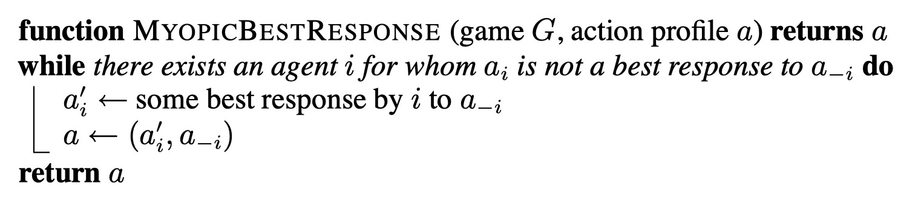
Myopic Best-Response
always terminates with Nash for potential games (but can cycle for general games)
but is this Nash Equilibrium necessarily pro-social?
"pro-social" outcome typically refers to an outcome that benefits all players or at least some of the players, as opposed to outcomes that are purely self-interested or competitive.
FIT5226-S2-2024
9/59
Notes:
The term "Myopic Best-Response" is a concept in game theory, particularly in the context of repeated or dynamic games. It refers to a player's strategy of responding to the current situation without considering the long-term consequences or without trying to optimize their overall performance.
Here's a more detailed explanation:
Myopic Strategy: When a player employs a myopic best-response strategy, they make decisions solely based on their current information, immediate payoff, or the actions of other players in the current round or stage of the game. They do not consider how their current decision might impact future rounds or the overall outcome of the game.
Immediate Optimization: The myopic best-response strategy is focused on immediate optimization. Players using this strategy aim to maximize their payoff or utility in the current round without taking into account the possibility of better outcomes in the future.
Limited Rationality: Myopic best-response strategies are often associated with bounded rationality, where players have limited computational resources or cognitive abilities. Instead of solving complex optimization problems, they simplify their decision-making by responding to the most recent information.
Example: In repeated games, a player employing a myopic best-response strategy might choose actions in each round that maximize their immediate gain, even if such actions lead to suboptimal long-term outcomes. They do not engage in strategic planning or consider how their actions might affect the behavior of other players in future rounds.
It's important to note that myopic best-response strategies are not always the best approach, especially in games with repeated interactions or where long-term planning can lead to more favorable outcomes. In some cases, players may use myopic strategies due to computational limitations or a lack of information about the long-term consequences of their actions.
In contrast to myopic strategies, other players may adopt more sophisticated strategies, such as tit-for-tat in repeated games, which involve considering the history of interactions and making decisions based on both current and past information. These strategies aim for better overall outcomes but may require more complex decision-making processes.

Slide 10
Selfish Routing (Price of Anarchy)
Nash=(A,B); (B,A)
here, Nash is pro-social
https://en.wikipedia.org/wiki/Congestion_game
FIT5226-S2-2024
10/59
Notes:
Just conclude the Nash AB and BA are pro-social (good for the group)

Slide 11
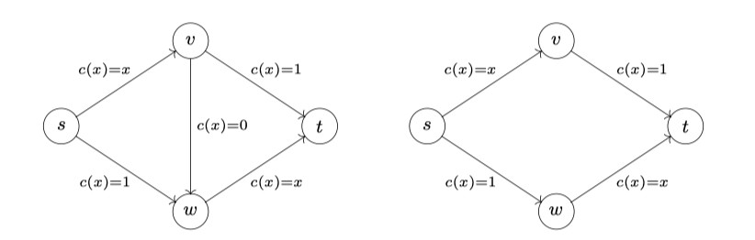
Braess’ Paradox or The problem with Nash
Nash isn’t always pro-social!
c (x) = x /100
c (x) = 45
c (x) = x /100
c (x) = 45
c (x) = 0
c (x) = 45
c (x) = x /100
c (x) = 45
c (x) = x /100
Removing a zero-cost edge improves social welfare!
Consider what is the Nash equilibrium (same travel time) for 4000 players
^{x}svt ^{x}swt
right : n = 4000 = x_{svt} + x_{swt} ∧ 45 +
= 45 +
⇒ x_{svt} = x_{swt} = 2000 is Nash
100 100
left : x_{svwt} = 4000 is Nash (and costs every player 15 minutes of travel time)
FIT5226-S2-2024
11/59
Notes:
Left:
$\frac{x}{100}+\frac{x}{100}=45+\frac{x}{100}$
$\frac{2x}{100}=\frac{4500+x}{100}$
$2x=4500+x$
$x=4500$
-------------------------- to find equilibrium
$\frac{x_{1}}{100}+\frac{x_{1}}{100}=45+\frac{x_{2}}{100}$
$\frac{2x_{1}}{100}=\frac{4500+x_{2}}{100}$
$2x_{1}=4500+x_{2}$ ,
We have $x_{1}+x_{2}=4000$,
$2x_{1}=4500+x_{2}$ => $2x_{1}=4500+4000−x_{1}$ => $x_{1}=2833.33$, $x_{2}=1166.67$

Slide 12
Learning in Populations games
Myopic best response is one particular form of how a population can learn “to play together.”
What happens if we apply our previous theory of learning (reinforcement learning) in a population of agents?
FIT5226-S2-2024
12/59
Notes:
Applying reinforcement learning (RL) in a population of agents to study how they learn to play together is a valuable approach to understanding the dynamics of learning and cooperation in population games. Here's how RL can be adapted for population games and what happens when it's applied:
Individual Learning: In traditional reinforcement learning, individual agents learn to make decisions by interacting with their environment. Each agent maintains its own policy (strategy) and updates it based on its own experiences and rewards. These policies can be learned using techniques like Q-learning or policy gradients.
Population-Based Reinforcement Learning: To apply RL to a population of agents in population games, you can consider each agent as an independent learner. Agents continue to make strategic decisions and update their policies based on their experiences. However, in the context of a population game, an agent's rewards may depend not only on its own actions but also on the actions and strategies of other agents in the population.
Interactions and Rewards: In a population game, the reward or payoff for each agent is typically a function of the entire population's strategies and their interactions. This means that an agent's reward is influenced by the choices made by others in the population. For example, in a congestion game, the payoff for choosing a particular route depends on the congestion level of that route, which is influenced by the choices of other agents.
Cooperative and Competitive Learning: RL in a population of agents can lead to various outcomes, depending on the nature of the game. Agents may learn to cooperate and coordinate their strategies for mutual benefit, or they may compete and adopt strategies to gain an advantage over others. The learning dynamics can result in the emergence of Nash equilibria or other stable states, depending on the specific game and learning algorithms used.
Exploration and Exploitation: Agents in a population game must balance exploration (trying new strategies) and exploitation (sticking with strategies that have yielded high rewards). The exploration-exploitation trade-off is a fundamental aspect of RL and can influence how agents learn to play together in population games.
Convergence and Equilibrium: The application of RL in a population of agents can lead to various learning dynamics, including convergence to Nash equilibria, cyclic behavior, or even the emergence of new cooperative strategies. The stability and convergence properties of these learning dynamics depend on the specifics of the game and the RL algorithms used.
In summary, applying reinforcement learning to study learning in population games provides a flexible and powerful framework for exploring how agents adapt and coordinate their strategies in large populations. It allows for the investigation of various learning dynamics, cooperative and competitive behaviors, and the emergence of equilibrium states in complex social and strategic interactions. The outcomes can provide insights into how populations of agents learn to play together and adapt to changing environments.

Slide 13
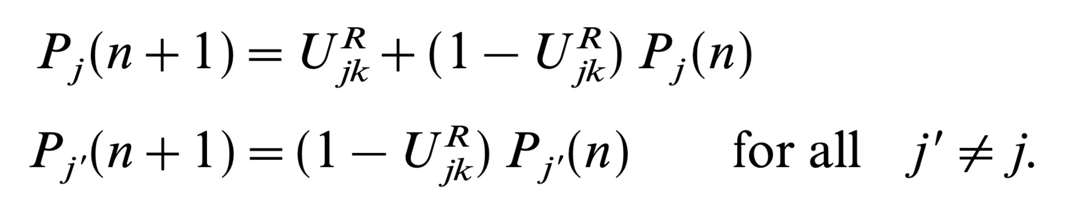
Individual Learning: Cross-Learning - Stateless RL
simplest form of RL
each player i keeps a probability for each of their possible actions to execute it.
agents reinforce these probabilities in the simplest possible way:
If action j is picked, it is reinforced proportionately to the utility (payoff) experienced;
If an action is not picked, its probability is decreased accordingly.
Börgers and Sarin, Learning Through Reinforcement and Replicator Dynamics, Journal of economic theory 77, 114 (1997)
FIT5226-S2-2024
13/59
Notes:
The equations represent an update rule in a cross-learning or reinforcement learning context, where agents are adapting their strategies over time based on their past experiences and interactions with others. Let's break down the equations:
In the equations:
$P_{j}(n+1)$represents the updated strategy or probability of action j at time n+1.
$P_{j^{′}}(n+1)$represents the updated probability of action j' at time n+1, where j' is any action other than j.
$U_{jk}^{R}$is a utility associated with the interaction between action j and k at time n for player R.
$(1−U_{jk}^{R})$represents the complementary probability of not receiving the utility value (reinforcement signal).
Here's an interpretation of these equations:
Update for Agent j $(P_{j}(n+1)):$
For two players, player 1 updates its probability for action j for the next time step (n+1) based on its current strategy $P_{j}(n)$and the reinforcement signal it received from interacting with action k of player 2 at time n.
If $U_{jk}^{R}$is 1, it means that agent j fully incorporates the reinforcement signal into its update, leading to a potential change in its strategy.
If $U_{jk}^{R}$is 0, it means that agent j completely ignores the reinforcement signal and retains its current strategy.
Updates for All Other Agents $(P_{j^{′}}(n+1)):$
All actions other than j (represented by j') update their probabilities for the next time step based on their current strategies $P_{j^{′}}(n).$
These agents do not directly incorporate the reinforcement signal $U_{jk}^{R}$into their updates. Instead, they update their strategies based on their current strategies with no reinforcement signal.
In this setup, it appears that action j is the only one influenced by the reinforcement signal from the interaction with action k. Other agents do not directly respond to this reinforcement signal.
The equations suggest a dynamic learning or adaptation process where agents' strategies evolve over time based on their experiences and the reinforcement signals they receive. The extent to which actions update their strategies depends on the value of $U_{jk}^{R}$, which may vary based on the specific learning or reinforcement learning algorithm being used.

Slide 14
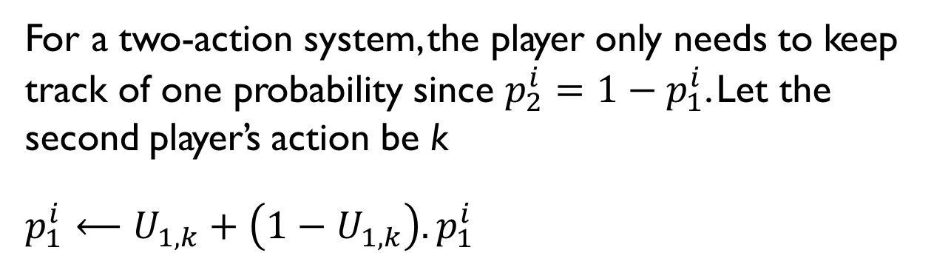
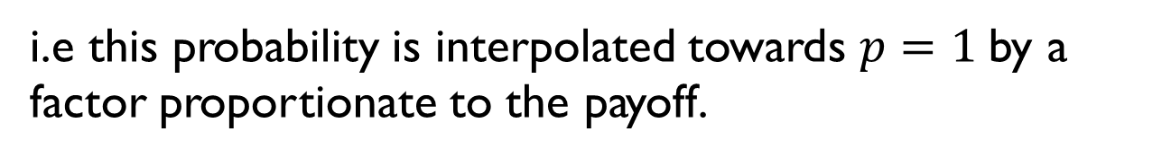
Cross Learning Dynamics
For a two-action system, the player only needs to keep track of one probability since $p_{2}^{i}=1−p_{1}^{i}$. Let the second player’s action be k
$p_{1}^{i}⟵U_{1,k}+\left(1−U_{1,k}\right).p_{1}^{i}$
i.e this probability is interpolated towards $p=1$by a factor proportionate to the payoff.
FIT5226-S2-2024
14/59
Notes:
This example of two actions. Learning dynamics in a two-action system, where a player updates their probability of choosing one of the two actions based on the payoffs associated with that action and the other action. This type of dynamics is used to model how players adapt their strategies over time in response to their experiences and payoffs. Let's break down the key components of this learning process:
Two-Action System: The game involves two possible actions or strategies that each player can choose from.
Updating Probability: Each player maintains a probability distribution over the two actions. In your description, you focus on the probability of choosing the first action, denoted as 𝑝₁ⁱ, where ⁱ represents the player's index.
Payoff-Dependent Update: The update rule for 𝑝₁ⁱ depends on the payoffs associated with the two actions and, notably, the difference between the payoff of the first action (U_(1, k)) and the payoff of the second action (U_(1, k)) for some opponent's action k.
Interpolation: The update involves an interpolation process. Specifically, 𝑝₁ⁱ is interpolated toward the value of 1, which suggests a tendency to increase the probability of choosing the first action.
Proportional to Payoff Difference: The interpolation factor is proportional to the difference between the payoff of the first action and the payoff of the second action (U_(1, k) - U_(2, k)). This means that if the first action yields a higher payoff compared to the second action for a given opponent's action k, the probability of choosing the first action increases, and vice versa.
This type of learning dynamics reflects how players adapt their strategies based on their past experiences and the relative payoffs associated with the available actions. It captures the idea that players are more likely to choose actions that have yielded higher payoffs in the past, with an interpolation factor determining the rate of adaptation.
These learning dynamics can be applied in various game-theoretic and strategic contexts to model how players adjust their strategies over time as they gain information about the game and their opponents' actions. Depending on the specific parameters and rules of the game, this learning process can lead to different equilibria or convergence behavior in repeated interactions.

Slide 15
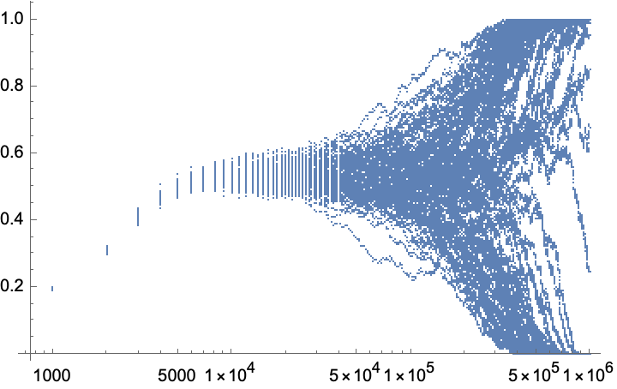
Cross-Learning Example: Car Park Problem
scatterplot probability
for each individual (whole population) against time
Probability of going to park A
Going to park B
Students and tutors are always trying to come to arrive for class just in time. Unfortunately, this means that everyone arrives at the car park at the same time! There are two different car parks available. Car park A is large but far away from the building. Car park B is small but close to the building. It takes only 2 minutes to walk to the tutorial rooms from car park B but 20 minutes from A. Unfortunately, it is never easy to find a parking spot straight away and the situation gets worse when more people are trying to find a spot. If n cars arrive simultaneously at the large car park A, each will suffer an n-minute delay. In the smaller car park B, each car will even suffer a delay of 5n-minutes if n cars are simultaneously looking for a spot.
FIT5226-S2-2024
15/59
Notes:
Agents:
Students and tutors (multiple agents), denoted as D1, D2, D3, ..., Dn.
Actions:
Each driver has two actions to choose from:
Action 1: Park in the large car park A, which is far away from the building.
Action 2: Park in the small car park B, which is close to the building.
Rewards/Payoffs:
The payoff or utility for each driver is based on their chosen action and the overall parking situation:
If a driver chooses car park A (Action 1), their payoff depends on the number of other drivers who also choose car park A simultaneously. Each driver in car park A suffers an n-minute delay, where n is the number of cars simultaneously arriving at car park A.
If a driver chooses car park B (Action 2), their payoff depends on the number of other drivers who also choose car park B simultaneously. Each driver in car park B suffers a delay of 5n minutes, where n is the number of cars simultaneously looking for a spot in car park B.
Additionally, drivers receive utility based on the time saved when walking to the tutorial rooms (2 minutes from car park B and 20 minutes from car park A).
Cross-Learning Process:
In this context, cross-learning involves drivers adapting their decisions based on the observed outcomes of other drivers' actions in previous rounds. The reinforcement or learning signal (U_{j k}^R) for each driver is determined by observing the outcomes of other drivers who chose different actions in terms of which car park they selected.
For example, if Driver D1 observes that many others chose car park B and experienced significant delays, D1 may be less inclined to choose car park B in the next round. Conversely, if D2 observes that some drivers chose car park A and faced delays, D2 may consider choosing car park B.
The learning process continues over multiple rounds, with drivers updating their strategies based on the observed outcomes of other drivers' actions.
The goal of cross-learning in this scenario is to reach a state where drivers' actions collectively lead to an efficient allocation of parking spaces, reducing congestion and minimizing the overall parking time for all drivers while taking into account the trade-off between walking time and parking delay.
This example illustrates how game theory and cross-learning concepts can be applied to real-world scenarios involving resource allocation and congestion management.

Slide 16
Interpretations of Mixed Strategies
Randomize individually
Frequencies in repeated games individually
Frequencies of occurrence in a population
ie Likelihood to meet certain opponents in a population game.
FIT5226-S2-2024
16/59
Notes:
Interpretations of mixed strategies in game theory are ways to understand how players make random or probabilistic choices among their available strategies. Here are two common interpretations:
Randomize Individually:
In this interpretation, a player using a mixed strategy is viewed as making probabilistic or random choices individually. It means that when faced with a decision, the player selects each available strategy with a certain probability.
For example, if a player has two pure strategies, A and B, and they are playing a mixed strategy (p, 1-p), this can be interpreted as the player choosing strategy A with probability p and strategy B with probability 1-p.
This interpretation is often used in the context of repeated games, where a player might randomize their choices over time to create uncertainty for their opponent.
Frequencies of Occurrence in a Population:
In this interpretation, mixed strategies represent the likelihood of a player encountering certain opponents or strategies in a population of players.
It assumes that the player is part of a larger population of players, and the mixed strategy reflects the distribution of opponents they are likely to face.
For example, if a player's mixed strategy involves playing strategy X with a certain probability, it can be interpreted as the likelihood of encountering opponents who are more responsive to strategy X.
This interpretation is commonly used in population games and evolutionary game theory, where players interact with each other based on their strategies, and the success of a strategy depends on its prevalence in the population.
Both interpretations provide insights into how players make strategic choices when faced with uncertainty or incomplete information about their opponents' actions. The choice of interpretation may depend on the specific context of the game being analyzed and the research question at hand.

Slide 17
Social Learning in Populations games
How can we understand the dynamics of this?
Much of our knowledge about learning in populations originates from evolutionary biology.
Evolutionary biology asks how species and populations adapt over time to the environment.
While this is a (subtly) different setting from learning
much of this theory can be applied to learning in populations.
FIT5226-S2-2024
17/59
Notes:
Social learning: Learning from others.
Social learning in population games is a concept from the field of game theory and evolutionary dynamics. It refers to the process by which individuals within a population learn and adapt their strategies based on the outcomes of interactions with other individuals. This concept is particularly relevant in the study of evolutionary game theory, where strategies that are more successful tend to spread through a population over time.
Social Learning: Social learning occurs when agents observe the strategies and payoffs of others in their population. Agents may adapt their own strategies based on the success or failure of strategies they observe in their peers.
Imitation and Innovation: Agents can learn from others through imitation (copying the strategies of more successful agents) or innovation (exploring new strategies).
Evolutionary Dynamics: Over time, successful strategies tend to become more prevalent in the population, while less successful strategies may decline in frequency. This process of strategy evolution is analogous to natural selection in biological evolution.
Evolutionary biology is a branch of biology that focuses on the study of how species and populations of organisms change over time through the process of evolution.

Slide 18

The Father of Evolutionary Game Theory
Maynard Smith (1986)
Evolution and the Theory of Games
Applied game theory to biological systems
Blind process of natural selection removes rationality assumption
“Let nature do the work and see what happens”
Results as if agents were rational, self-interested fitness maximizers
FIT5226-S2-2024
18/59

Slide 19
EGT Departures from Classical Game Theory
Population-level thinking (rather than two players)
Interpretations as evolutionary or social process
Games are repeated
Stochastic model
can also be interpreted as LEARNING !!
Learning / imitation of behaviour
Rationality not presumed
Perfect Information (underlies rationality) not required
FIT5226-S2-2024
19/59
Notes:
Evolutionary Game Theory (EGT) is a branch of game theory that departs from classical game theory in several key ways, incorporating concepts from biology, population dynamics, and behavioral sciences. Here are some of the departures and unique features of EGT:
Population-Level Thinking: In classical game theory, the focus is often on interactions between two or more rational players. In EGT, the focus shifts to the dynamics of a population of individuals or entities, each with its own strategy. EGT examines how the frequencies of different strategies change within a population over time.
Interpretations as Evolutionary or Social Process: EGT often interprets game interactions as evolutionary processes, where strategies that are more successful in terms of fitness or payoffs tend to become more prevalent over generations. It can also be seen as a model for social processes, where individuals adapt their behaviors based on observed outcomes.
Games Are Repeated: While classical game theory considers one-shot games, EGT frequently deals with repeated games. Strategies evolve and persist over multiple rounds of interactions, allowing for the emergence of stable strategies.
Stochastic Model: EGT often incorporates stochastic elements, such as random mutation or random interactions. These stochastic elements introduce randomness into the model, reflecting real-world uncertainty.
Learning/Imitation of Behavior: In EGT, agents may learn from their own experiences or imitate the strategies of others based on observed success. Learning or imitation mechanisms are crucial in understanding strategy dynamics.
Rationality Not Presumed: Unlike classical game theory, EGT does not assume that players are always fully rational decision-makers. Agents in EGT may have limited information, make errors, or adapt their strategies based on simpler rules, such as imitating successful strategies.
Perfect Information Not Required: EGT does not require that players have perfect information about the game or the strategies of other players. Learning and adaptation can occur even in the presence of incomplete or imperfect information.
EGT provides a framework for studying the evolution of strategies in situations where individuals or entities adapt and compete for limited resources or success. It is widely used in biology, economics, sociology, and other fields to analyze and model scenarios where strategic interactions and learning processes shape the behavior of populations over time. The departure from classical game theory allows EGT to capture more realistic and dynamic aspects of strategic decision-making.

Slide 20
Domains
Biology
evolution (this is the origin)
group behaviour
Economics
behavioural economics
e.g. public goods games
Social Behaviour
Psychology
History (Cultural Evolution)
• …
FIT5226-S2-2024
20/59

Slide 21
Key Questions
Which strategies “survive”, which vanish?
as agents learn from each other (social learning)
What is the strategy distribution
For a population in a stationary state (equilibrium)?
convergence on a single strategy or coexistence of different strategies?
may not be convergent but enter limit cycle
can a new strategy variation invade
(mutation/innovation)
can it displace the old strategy(ies)?
FIT5226-S2-2024
21/59
Notes:
1. Which Strategies "Survive," Which Vanish as Agents Learn from Each Other (Social Learning)?
This question relates to the evolution of strategies within a population over time as individuals or agents adapt and learn from each other. The answers can vary depending on the specifics of the game and the learning mechanisms involved:
Survival of Strategies: Successful strategies, those that yield higher payoffs or fitness, tend to survive and become more prevalent in the population. This survival is driven by the ability of individuals using these strategies to outperform others.
Vanishing Strategies: Less successful or poorly performing strategies may gradually vanish from the population as individuals using these strategies experience lower payoffs or fitness.
Coexistence: In some cases, multiple strategies may coexist in the population in a stable equilibrium. This coexistence can result from frequency-dependent selection, where the success of a strategy depends on its frequency relative to other strategies.
Limit Cycles: Instead of converging to a single strategy, the population may enter limit cycles, where strategy frequencies oscillate over time. This behavior can arise in cyclic or rock-paper-scissors-like games.
Invasion of New Strategies: New strategy variations, either through mutation or innovation, can potentially invade the population if they offer a competitive advantage over existing strategies. Their success depends on their initial frequency and the selective pressures in the environment.
Displacement of Old Strategies: Successful new strategies can displace old strategies if they outperform them. This displacement can lead to shifts in the strategy distribution within the population.
2. What Is the Strategy Distribution for a Population in a Stationary State (Equilibrium)?
Understanding the strategy distribution in a stationary state or equilibrium is essential for characterizing the long-term dynamics of the population. Different scenarios can arise:
Convergence: The population may converge to a stationary state where a single dominant strategy is prevalent. This scenario often occurs in symmetric games with strong selection.
Coexistence: Equilibria can involve the coexistence of multiple strategies. These equilibria can be stable and lead to the persistence of strategy diversity in the population.
Limit Cycles: Some systems may enter limit cycles, where strategy frequencies fluctuate without converging to a fixed equilibrium. This can result from the cyclic nature of the game.
Invasion and Replacement: Equilibria can be disrupted by the invasion of new strategies. These invaders may or may not displace existing strategies, leading to dynamic shifts in the equilibrium.
In evolutionary game theory, the strategy distribution in equilibrium is a central focus, as it provides insights into the stable states of populations and how they respond to changes in the environment, mutations, or innovations. The study of these questions helps researchers understand the mechanisms driving strategy evolution and the factors that contribute to the persistence or extinction of strategies within populations.

Slide 22
Evolution, Learning …
FIT5226-S2-2024
22/59

Slide 23
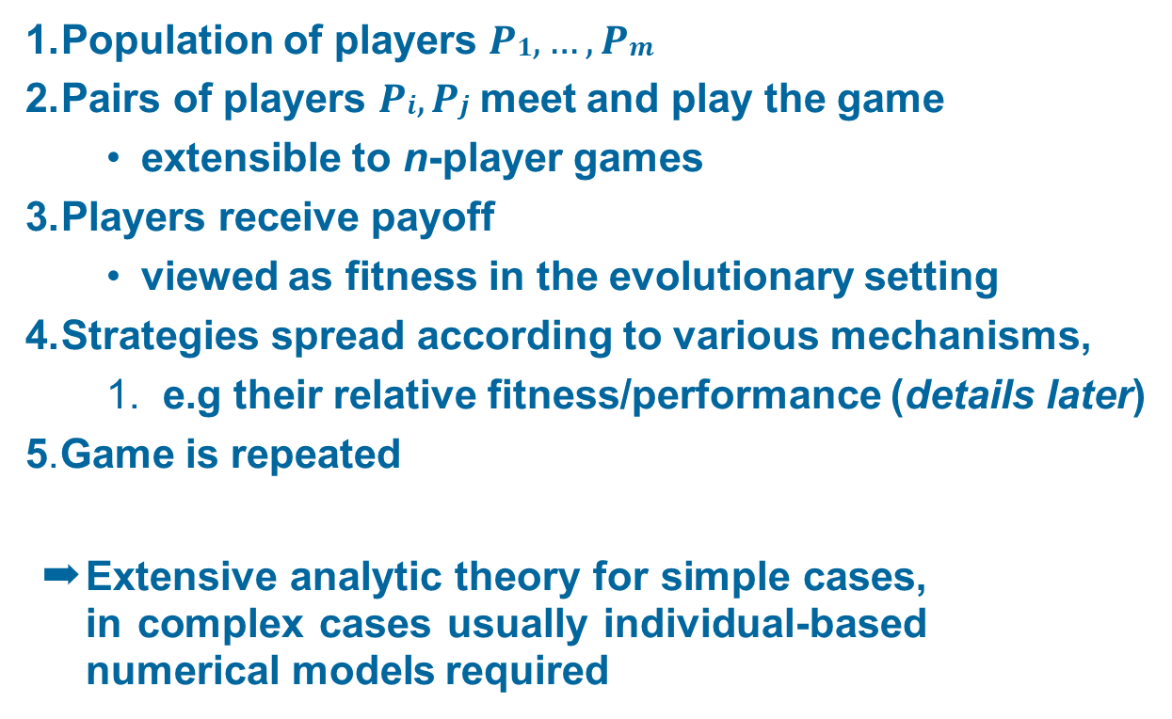
General EGT framework
Population of players $P1, …, Pm$
Pairs of players $Pi, Pj$meet and play the game
extensible to n-player games
Players receive payoff
viewed as fitness in the evolutionary setting
Strategies spread according to various mechanisms,
1. e.g their relative fitness/performance (details later)
5.Game is repeated
➡ Extensive analytic theory for simple cases, in complex cases usually individual-based numerical models required
FIT5226-S2-2024
23/59
Notes:
The framework outlines the fundamental components of evolutionary game theory (EGT) and how it is applied to model and study the dynamics of strategy evolution within a population of players. Let's break down each component:
1. Population of Players (P1, ..., Pm):
EGT considers a population consisting of multiple individuals or players, denoted as P1, P2, ..., Pm. These players represent entities making strategic decisions or engaging in interactions within a given context.
2. Pairs of Players (Pi, Pj) Meet and Play the Game:
In the context of evolutionary game theory, players interact in pairs (Pi, Pj) and play a specified game, which could be a two-player or, as you mentioned, extensible to n-player games. These interactions are the basis for strategy selection and payoff determination.
3. Players Receive Payoff:
After playing the game, each player receives a payoff, which is often viewed as a measure of their fitness in the evolutionary context. The payoff depends on the strategies chosen by both players in the interaction.
4. Strategies Spread According to Various Mechanisms:
The core of EGT lies in how strategies spread or evolve within the population. This spread is driven by various mechanisms, such as relative fitness or performance of strategies. Strategies that yield higher payoffs or fitness tend to proliferate within the population.
5. Game Is Repeated:
The game is typically repeated over multiple rounds or generations, allowing for the observation of strategy dynamics and the emergence of equilibria or stable states within the population.
Analytic Theory and Numerical Models:
EGT provides extensive analytical theory for simple cases where the dynamics of strategy evolution can be described mathematically and analytically. In these cases, researchers can derive insights into the behavior of strategies, equilibria, and evolutionary outcomes.
However, in complex scenarios or when dealing with more intricate games and interactions, individual-based numerical models, such as agent-based simulations, may be required. These models allow researchers to study strategy evolution in a more detailed and realistic manner.
Overall, EGT is a powerful framework for studying how strategies evolve and persist within populations. It finds applications in various fields, including biology, economics, sociology, and computer science, where strategic interactions and evolutionary dynamics play a significant role.

Slide 24
First Analysis: Assumptions
Games are repeated.
Strategies spread according to (proportional to) success.
This could be evolution (survival-of-the-fittest) or social learning
Players are interchangeable and indistinguishable, except for strategy (as in population games)
this implies that all players have the same strategy set
it also implies that the game must be symmetric
i.e. the game is agnostic about the players’ roles
FIT5226-S2-2024
24/59
Notes:
It outlines several key assumptions for analyzing games. Here's a slightly restructured version for better readability:
Assumptions for Game Analysis:
Repeated Games: The games in question are played repeatedly over time.
Strategy Success Spread: Strategies propagate based on their success, following principles of either evolution (survival-of-the-fittest) or social learning.
Interchangeable Players: Players are interchangeable and indistinguishable, except for their chosen strategies, akin to population games.
Uniform Strategy Set: All players possess the same set of strategies.
Symmetric Game: The game itself is symmetric and does not differentiate between the roles or identities of the players.
These assumptions provide a foundation for analyzing the dynamics of games under these conditions.

Slide 25

Symmetric Games
Players are interchangeable, i.e. a_{i,j} = b_{j,i} or
A = B^{T}
Since players are interchangeable we only consider symmetric pairs (x, x) for an equilibrium.
A strategy x is a Nash equilibrium if for all other strategies z:
It turns out that every symmetric game has a symmetric Nash Eq
x^{T} Ax ≥ z^{T} Ax
FIT5226-S2-2024
25/59
Notes:
the concept of symmetric games and the conditions for a Nash equilibrium in such games. Let me break down the terms and concepts you've mentioned:
Symmetric Games: In symmetric games, players are interchangeable, meaning that there is no distinction between them. This interchangeability often occurs in games where the strategies and payoffs of each player are identical. In other words, if player A chooses strategy i, and player B chooses strategy j, the payoff for A is the same as the payoff for B when player B chooses strategy i and player A chooses strategy j, i.e., aᵢⱼ = bⱼᵢ. This interchangeability can be represented mathematically as A = B^T, where A is the payoff matrix and B^T is the transpose of B.
Symmetric Pairs: In symmetric games, you only consider pairs of strategies where both players choose the same strategy. This is because, in such games, there is no distinction between the players, so (x, x) represents a symmetric pair of strategies.
Nash Equilibrium: A Nash equilibrium is a set of strategies in which no player can improve their payoff by unilaterally changing their strategy, given that all other players are also playing their equilibrium strategies. In a symmetric game, a strategy x is a Nash equilibrium if, for all other strategies z, the following condition holds:
x^T Ax ≥ z^T Ax
Here, x^T represents the transpose of the strategy vector x, A is the payoff matrix, and z is another strategy vector.
In simpler terms, this condition means that the strategy x is a Nash equilibrium if the payoff obtained by playing x when all players play x is greater than or equal to the payoff obtained by playing any other strategy z when all players play x. In other words, no player has an incentive to deviate from the strategy x, given that all other players are also playing x.
This condition ensures that no player can unilaterally improve their outcome by changing their strategy while others remain unchanged, which is the essence of a Nash equilibrium.
In summary, in symmetric games, Nash equilibria are pairs of strategies (x, x) where the payoff for both players is maximized, and no player has an incentive to switch to a different strategy, as long as all other players are also playing the same strategy x.

Slide 26
Nash Equilibrium & Process Dynamics
A dynamic process that always moves in the direction of increased payoff can only stop at a Nash Equilibrium
Can a mutant overturn a Nash Equilibrium?
a mutant player can potentially disrupt an existing equilibrium if they perform better.
FIT5226-S2-2024
26/59
Notes:
The statement "A dynamic process that always moves in the direction of increased payoff can only stop at a Nash Equilibrium" is a fundamental concept in game theory. It relates to the idea that rational players, who seek to maximize their payoffs, will tend to move towards a Nash Equilibrium over time as they adjust their strategies. This concept is often referred to as the "best response dynamics" or "imitation dynamics."
Here's a more detailed explanation:
Best Response Dynamics: In many game settings, players have the tendency to adjust their strategies in a way that improves their payoffs. This means that if a player observes that changing their strategy would result in a higher payoff, they are likely to make that change.
Convergence to Nash Equilibrium: If all players in a game follow best response dynamics, continuously adjusting their strategies to maximize their payoffs, the process tends to converge towards a Nash Equilibrium. This is because, by definition, a Nash Equilibrium is a set of strategies where no player can unilaterally improve their payoff by changing their strategy while others keep their strategies fixed. So, as players iteratively update their strategies to improve their payoffs, they naturally gravitate towards a state where no one has an incentive to deviate further.
Now, regarding your question about mutants overturning a Nash Equilibrium:
Mutants and Nash Equilibrium: In the context of a Nash Equilibrium, a "mutant" refers to a player who deviates from the equilibrium strategy. If a Nash Equilibrium is reached, it means that, at that moment, no player has an incentive to change their strategy given what others are doing.
Overturning a Nash Equilibrium: It is possible for a mutant to overturn a Nash Equilibrium if their deviation creates a new set of strategies that forms a new equilibrium. This new equilibrium may result in different payoffs for the players involved. However, overturning an existing Nash Equilibrium typically requires that the mutant's deviation is profitable for them and potentially prompts other players to change their strategies in response. This can lead to a shift away from the original equilibrium.
In summary, while Nash Equilibria represent stable points in a game where players have no incentive to unilaterally change their strategies, a mutant player can potentially disrupt an existing equilibrium by deviating if their deviation leads to a new equilibrium with different payoffs. Whether or not this occurs depends on the specific dynamics of the game and the strategies chosen by the mutant and other players in response to the deviation.

Slide 27
Evolutionary Stable Strategy
Imagine a large population of players, randomly drawn to play a symmetric game
mutation
P
The payoffs of the game are assumed to be “fitnesses” in the sense that a process of (natural) selection favours those earning higher payoffs
Q
P
P
What is the condition for selection to oppose the invasion of a mutant?
P is ESS if it is able to repel any mutant Q that comes in a small quantity
FIT5226-S2-2024
27/59
Notes:
In the context of evolutionary game theory, an Evolutionarily Stable Strategy (ESS) is a strategy that, if adopted by a population, cannot be invaded by a mutant strategy under the process of natural selection. In other words, an ESS is a strategy that is resistant to being replaced by an alternative strategy when introduced into a population.
To determine the condition for selection to oppose the invasion of a mutant strategy, you need to consider the concept of the "invasion fitness" of the mutant strategy compared to the resident (existing) strategy in the population.
Here's the condition for selection to oppose the invasion of a mutant strategy:
Definition of an ESS: A strategy x is an ESS if, and only if:
Strategy x is already present in the population as the resident strategy.
A mutant strategy y is introduced into the population, with a small proportion of individuals playing y.
The expected payoff (fitness) of the mutant strategy y when interacting with the resident strategy x is less than or equal to the expected payoff of the resident strategy x when interacting with itself.
Mathematically, this condition can be expressed as:
u(y, x) ≤ u(x, x)
Where:
u(y, x) represents the expected payoff (fitness) of the mutant strategy y when it interacts with the resident strategy x.
u(x, x) represents the expected payoff (fitness) of the resident strategy x when it interacts with itself.
In simpler terms, the mutant strategy y must perform worse (or at least not perform better) than the resident strategy x when both interact with the same strategy x. This condition ensures that the mutant strategy cannot invade and replace the resident strategy because it is not as fit as the resident strategy when playing against itself.
This concept is closely related to the idea of natural selection favoring strategies that result in higher payoffs, as strategies with higher payoffs are more likely to persist and dominate a population over time.
In summary, for natural selection to oppose the invasion of a mutant strategy, the mutant strategy must perform worse or at least not perform better than the resident strategy when they interact with each other. This is a fundamental condition for an Evolutionarily Stable Strategy (ESS).

Slide 28


Slide 29
Competition for food
When beetles of the same size compete, they get equal shares of the food
When a large beetle competes with a small beetle, the large beetle gets the majority of the food.
In all cases, large beetles experience less of a fitness benefit from a given quantity of food, since some of it is diverted into maintaining their expensive metabolism
FIT5226-S2-2024
29/59
Notes:
a competitive scenario among beetles in which the size of the beetles plays a crucial role in determining their access to food resources and their fitness. This scenario can be analyzed using concepts from ecology and evolutionary biology.
In this context:
Beetles of the Same Size Get Equal Shares of Food: This suggests that when beetles of the same size compete, they have similar abilities to access and obtain food resources. This might be because they have similar feeding mechanisms or competitive abilities, resulting in an equitable distribution of food resources among them.
Large Beetles vs. Small Beetles: When a large beetle competes with a small beetle, the large beetle outcompetes the small beetle for food and obtains the majority of the food resources. This might be due to size-related advantages, such as greater physical strength or the ability to intimidate smaller beetles.
Metabolic Costs for Large Beetles: Despite obtaining more food, large beetles experience reduced fitness benefits from the food they acquire because a portion of it is diverted into maintaining their expensive metabolism. This phenomenon is consistent with the concept that larger organisms often have higher metabolic rates, which require more energy to sustain.
In ecological and evolutionary terms, this scenario can be related to resource competition, size-dependent advantage, and trade-offs between resource acquisition and maintenance costs:
Resource Competition: The competition for limited food resources among beetles can lead to the success of certain individuals (e.g., large beetles) over others (e.g., small beetles), depending on their competitive abilities and resource acquisition strategies.
Size-Dependent Advantage: The fact that large beetles tend to dominate in competition with smaller beetles highlights a size-dependent advantage. In some cases, larger individuals may have greater access to resources due to their size-related traits or abilities.
Trade-Offs: The observation that large beetles experience reduced fitness benefits due to higher metabolic costs illustrates a trade-off. In evolutionary biology, organisms often face trade-offs between allocating resources to growth and maintenance (e.g., metabolism) versus reproduction and other fitness-related activities.
Overall, this scenario showcases how ecological interactions and trade-offs can shape the distribution of resources and the fitness outcomes of individuals within a population of beetles, considering their size-related differences and competitive dynamics.

Slide 30
Body Size Game
Beetle 2
 | Small | Large
Small | 5, 5 | 1, 8
Large | 8, 1 | 3, 3
Beetle 1
FIT5226-S2-2024
30/59
Notes:
The table you've provided appears to represent a simplified two-player game or a strategic interaction between two types of beetles, Small and Large, where each player, Beetle 1 and Beetle 2, can choose between two strategies: Small or Large. The numbers in each cell of the table represent the payoffs (or benefits) to the respective players based on their chosen strategies.
Here's how to interpret the payoffs:
When both Beetle 1 and Beetle 2 choose the Small strategy, they each receive a payoff of 5.
When Beetle 1 chooses the Small strategy (row) and Beetle 2 chooses the Large strategy (column), Beetle 1 receives a payoff of 1, and Beetle 2 receives a payoff of 8.
When Beetle 1 chooses the Large strategy (row) and Beetle 2 chooses the Small strategy (column), Beetle 1 receives a payoff of 8, and Beetle 2 receives a payoff of 1.
When both Beetle 1 and Beetle 2 choose the Large strategy, they each receive a payoff of 3.
These payoffs represent the outcomes of their interactions in a competitive context. The numbers reflect the relative fitness or success of each type of beetle based on their strategy choices.
For example, if Beetle 1 chooses Small and Beetle 2 chooses Large, Beetle 1 gets a low payoff of 1, while Beetle 2 gets a high payoff of 8, suggesting that in this interaction, a Large beetle has a competitive advantage over a Small one.
In this game, there are several possible equilibria:
(Small, Small) is a Nash equilibrium because neither player has an incentive to unilaterally deviate to a different strategy, as both receive a payoff of 5, which is the best they can achieve when the other player chooses Small.
(Large, Large) is also a Nash equilibrium for the same reason. Neither player has an incentive to change strategy because they both receive a payoff of 3, which is the best they can achieve when the other player chooses Large.
(Small, Large) and (Large, Small) are not Nash equilibria because in both cases, one player has an incentive to switch to the strategy chosen by the other player to improve their payoff.
The outcome of which equilibrium is reached in a population of these beetles would depend on factors such as the initial distribution of strategies and the dynamics of how they interact and adapt over time.

Slide 31
Body Size Game: Invasion of a small mutant
Fraction of small Beetles: x
Fraction of large Beetles: 1-x
payoff in a population where
Large is the majority (x is close to 0)
Large Beetle: 8 * x + 3 * (1-x) = 3 + 5x ~ 3 Small Beetle: 5 * x + 1 * (1-x) = 1 + 4x ~ 1
Large is evolutionary stable
FIT5226-S2-2024
31/59
Notes:
In evolutionary game theory, determining whether a strategy is evolutionarily stable involves analyzing whether a mutant strategy can invade and replace the resident strategy within a population. In this case, we are considering the invasion of a small mutant (x) into a population where large beetles are the majority (1 - x).
Let's break down the provided calculations:
Payoff of Large Beetles in a Population where Large is the Majority (x is close to 0):
Payoff for Large Beetles: 8 * x + 3 * (1 - x)
Simplifying: 8x + 3 - 3x
This results in a payoff of 5x + 3 for Large Beetles.
Payoff of Small Beetles in the Same Population:
Payoff for Small Beetles: 5 * x + 1 * (1 - x)
Simplifying: 5x + 1 - x
This results in a payoff of 4x + 1 for Small Beetles.
Now, we want to determine whether Large Beetles are evolutionarily stable in this population. To do so, we need to compare the fitness (payoff) of the resident strategy (Large Beetles) to that of the mutant strategy (Small Beetles).
Resident Strategy (Large Beetles): Fitness is 5x + 3.
Mutant Strategy (Small Beetles): Fitness is 4x + 1.
To assess whether Large Beetles are evolutionarily stable, we need to check if the resident strategy (Large Beetles) has a higher fitness than the mutant strategy (Small Beetles) for small values of x.
In this case, as x approaches 0 (i.e., when Large Beetles are the vast majority), the fitness of Large Beetles is 3 (which is higher) compared to the fitness of Small Beetles, which is 1.
So, yes, Large Beetles are evolutionarily stable in a population where they are the majority (x is close to 0). In this scenario, a small mutant invasion of Small Beetles is not successful because Large Beetles have a higher fitness when they are the majority, as indicated by the higher payoff. This means that Large Beetles can resist invasion by Small Beetles when they are the dominant group in the population.

Slide 32
Body Size Game: Invasion of a large mutant
Fraction of large Beetles: x
Fraction of small Beetles: 1-x
(swapped)
payoff in a population where
Small is the majority (x is close to 0)
Large Beetle: 8 * (1-x) + 3 * x = 8 - 5x ~ 8
Small Beetle: 5 * (1-x) + 1 * x = 5 - 4x ~ 4
Small is not evolutionary stable
FIT5226-S2-2024
32/59
Notes:
In this scenario, we are examining the evolutionary stability of Small Beetles in a population where they are the majority (x is close to 0) and comparing their fitness to that of Large Beetles. The payoffs for Small and Large Beetles in this context are as follows:
Payoff of Small Beetles in a Population where Small is the Majority (x is close to 0):
Payoff for Small Beetles: 5 * (1 - x) + 1 * x
Simplifying: 5 - 5x + x
This results in a payoff of 5 - 4x for Small Beetles.
Payoff of Large Beetles in the Same Population:
Payoff for Large Beetles: 8 * (1 - x) + 3 * x
Simplifying: 8 - 8x + 3x
This results in a payoff of 8 - 5x for Large Beetles.
Now, you want to determine whether Small Beetles are evolutionarily stable in this population. To do so, you need to compare the fitness (payoff) of the resident strategy (Small Beetles) to that of the mutant strategy (Large Beetles).
Resident Strategy (Small Beetles): Fitness is 5 - 4x.
Mutant Strategy (Large Beetles): Fitness is 8 - 5x.
To assess whether Small Beetles are evolutionarily stable, you need to check if the resident strategy (Small Beetles) has a higher fitness than the mutant strategy (Large Beetles) for small values of x.
In this case, as x approaches 0 (i.e., when Small Beetles are the vast majority), the fitness of Small Beetles is 5 (which is lower) compared to the fitness of Large Beetles, which is 8.
So, Small Beetles are not evolutionarily stable in a population where they are the majority (x is close to 0). In this scenario, Large Beetles have a higher fitness when Small Beetles are the majority, as indicated by the higher payoff. This means that Large Beetles can successfully invade a population dominated by Small Beetles.

Slide 33
Evolutionarily Stable Strategy
Π(P, P) > Π(Q, P)
∀ Q ≠ P
Mutant strategy
Π(P, P) represents the expected payoff when playing strategy P within a population that predominantly plays strategy P.
Q
P
Q must be worse off for P to be ESS!
With small mutation rates, the competition is in a “mostly P” environment
Since expected payoffs can be linearly interpolated:
$$\prod{\left(P, εQ+\left(1−ε\right)P\right)>\prod{\left(Q,εQ+\left(1−ε\right)P\right)} ∀Q≠P, small ε}$$
Π typically represents the expected payoff (or fitness)
FIT5226-S2-2024
33/59
Notes:
These are the conditions for an Evolutionarily Stable Strategy (ESS) using the concept of expected payoffs and small mutation rates in a "mostly P" environment. Let's break down the key points you've mentioned:
ESS Condition - Π(P, P) > Π(Q, P) ∀ Q ≠ P: This is the fundamental condition for a strategy P to be an ESS. It signifies that strategy P is evolutionarily stable because it performs better when interacting within a population that predominantly plays strategy Π(P, P) than any other alternative strategy Q does when interacting with Π(Q, P). This condition ensures that strategy P is resistant to invasion by other strategies in a population where P is the dominant strategy.
Interpolation of Expected Payoffs: You correctly point out that expected payoffs can be linearly interpolated between strategies. This means that if there's a small mutation rate (represented by ε), and a population is mostly composed of strategy P, you can approximate the expected payoff of any strategy Q when interacting with this population. This approximation is given by:
Π(P, εQ + (1 - ε)P) > Π(Q, εQ + (1 - ε)P) for all Q ≠ P, where ε is small.
This equation considers that a small fraction ε of the population adopts strategy Q, and the majority (1 - ε) follows strategy P.
Now, let's put this into context:
When a strategy P is an ESS, it means that it is resistant to invasion by any mutant strategy Q in a population where P is the dominant strategy.
The interpolation condition you mentioned ensures that even when there are small deviations (mutations) from P in the population, strategy P still performs better than any alternative strategy Q. This is essential for the stability of strategy P.
Essentially, it suggests that strategy P can maintain its dominance in the presence of small mutations or deviations from the majority strategy P.
In summary, the concept of expected payoffs and the interpolation condition you've described are fundamental in understanding the stability of strategies in evolutionary game theory. An ESS is a strategy that performs well against itself and resists invasion by alternative strategies, even when those alternatives are present in small proportions due to mutations or deviations.

Slide 34
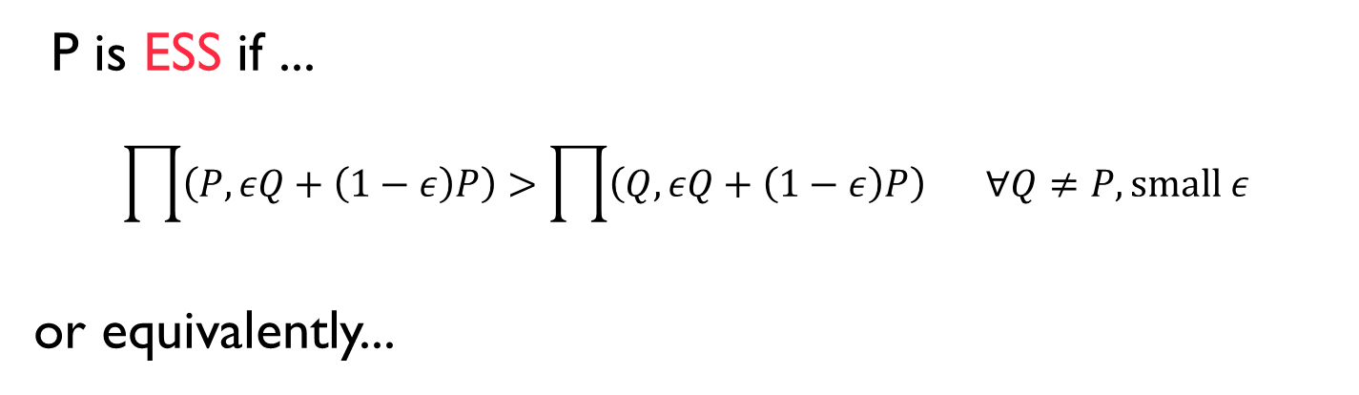
What happens in Nash neighbourhood ?
P is ESS if ...
$$\prod{\left(P, εQ+\left(1−ε\right)P\right)>\prod{\left(Q,εQ+\left(1−ε\right)P\right)} ∀Q≠P, small ε}$$
or equivalently...
Non strict
Nash Equilibrium
FIT5226-S2-2024
34/59
Notes:
The summary of the relationship between Evolutionarily Stable Strategies (ESS) and Nash Equilibrium. Let's break it down step by step:
ESS Condition with Small ε: This states that for a strategy P to be an ESS, it should satisfy the condition:
Π(𝑃, 𝜖𝑄+(1−𝜖)𝑃) > Π(𝑄,𝜖𝑄+(1−𝜖)𝑃) for all Q ≠ P and small ε.
This condition checks whether strategy P remains advantageous even when a small fraction ε of the population adopts strategy Q. In other words, P should outperform any alternative strategy Q in a population where P is prevalent.
Equivalence to Nash Equilibrium: the equivalence between ESS and Nash Equilibrium:
If Π(P, P) = Π(Q, P), this implies that strategy P is as good as any alternative strategy Q when interacting with itself (Nash Equilibrium condition).
In such a case, to be an ESS, P must also satisfy the condition Π(P, Q) ≥ Π(Q, Q) for all Q ≠ P. This means that even though P performs equally well as Q when interacting with itself, it should still perform better when interacting with Q than Q performs with itself.
In summary:
ESS is a concept from evolutionary game theory, focusing on the stability of strategies within a population over time.
The ESS condition with small ε evaluates whether a strategy remains advantageous even when a small fraction of the population adopts a different strategy.
ESS and Nash Equilibrium are related, and when Π(P, P) equals Π(Q, P) in a population (Nash Equilibrium), the ESS condition requires that P still performs better when interacting with Q than Q performs with itself to be evolutionarily stable.

Slide 35
ESS is a refinement of Nash
NE
ESS
FIT5226-S2-2024
35/59
Notes:
This means every ESS is a Nash Eq. Anything not-Nash can not be evolutionary stable

Slide 36
Strict Nash implies an ESS
Strict Nash
NE
ESS
FIT5226-S2-2024
36/59
Notes:
A strict Nash equilibrium is indeed stronger than an Evolutionarily Stable Strategy (ESS).
Strict Nash Equilibrium: In a strict Nash equilibrium, each player's strategy is the best response to the others, and any deviation from that strategy strictly reduces the player's payoff. No player can benefit by unilaterally changing their strategy, even if the deviation is small. This creates a very stable situation in terms of individual incentives.
Evolutionarily Stable Strategy (ESS): ESS is a concept from evolutionary game theory. An ESS is a strategy that, if adopted by most of the population, cannot be invaded by a small group of players using a different (mutant) strategy. It is a refinement of the Nash equilibrium, but not as strong as a strict Nash. While an ESS ensures that small deviations won't overtake the population, it doesn't require that deviations lead to a strictly lower payoff, as in strict Nash equilibrium.
Thus, if you have a strict Nash equilibrium, it automatically satisfies the conditions of an ESS. However, not all ESSs are strict Nash equilibria.

Slide 37
ESS - Existence
Let G be a two-player symmetric game with 2 pure strategies such that
Π(s₁, s₁) ≠ Π(s₂, s₁) ∧ Π(s₂, s₂) ≠ Π(s₁, s₂)
then G has an ESS.
FIT5226-S2-2024
37/59
Notes:
The equation Π(s1, s1) ≠ Π(s2, s1) ∧ Π(s2, s2) ≠ Π(s1, s2) represents a condition in game theory involving payoffs in a two-player symmetric game with two pure strategies. Let's break it down:
Π(s1, s1): This represents the payoff that both players receive when they both choose strategy s1.
Π(s2, s1): This represents the payoff that Player 1 receives when they choose strategy s2, and Player 2 chooses strategy s1.
Π(s2, s2): This represents the payoff that both players receive when they both choose strategy s2.
Π(s1, s2): This represents the payoff that Player 1 receives when they choose strategy s1, and Player 2 chooses strategy s2.
The condition Π(s1, s1) ≠ Π(s2, s1) ∧ Π(s2, s2) ≠ Π(s1, s2) means that there are differences in payoffs between these pairs of strategies. Specifically:
Π(s1, s1) ≠ Π(s2, s1): This indicates that the payoff for both players when they both choose strategy s1 is not equal to the payoff for Player 1 when they choose s2 and Player 2 chooses s1. In other words, there is a difference in payoffs between s1 vs. s1 and s2 vs. s1.
Π(s2, s2) ≠ Π(s1, s2): This indicates that the payoff for both players when they both choose strategy s2 is not equal to the payoff for Player 1 when they choose s1 and Player 2 chooses s2. In other words, there is a difference in payoffs between s2 vs. s2 and s1 vs. s2.
This condition suggests that there are variations in the outcomes and payoffs associated with different strategy combinations. It can have implications for the strategic choices that players make in the game and can affect the stability and dynamics of the game.

Slide 38
Replicator Dynamics
A dynamic systems description of evolutionary dynamics
Replicator dynamics assumes exact copying of the behaviour proportional to fitness / success
other types of learning / imitation (and thus dynamics) have been investigated
FIT5226-S2-2024
38/59
Notes:
Replicator dynamics is a mathematical framework used to model and describe evolutionary dynamics in populations of interacting individuals, particularly in the context of game theory and evolutionary biology. This framework is based on the assumption of exact copying of behaviors, where the frequency of a particular strategy in a population is proportional to the fitness or success of that strategy.
Key points about replicator dynamics:
Exact Copying: In replicator dynamics, it is assumed that individuals within a population can precisely copy the strategies of others. This assumption simplifies the modeling of evolutionary processes, as it implies that individuals do not engage in learning, innovation, or any form of error in replicating strategies.
Proportional to Fitness: The frequency of a strategy in the population changes over time in a manner that is directly proportional to the fitness or success of that strategy. Strategies with higher fitness values become more prevalent in the population over time, while strategies with lower fitness values decrease in frequency.
Equilibrium Points: Replicator dynamics can be analyzed to identify equilibrium points, where the frequencies of strategies no longer change. These equilibrium points are often associated with concepts like Nash Equilibrium in game theory, where no strategy can unilaterally improve its fitness by switching to a different strategy.
Stability and Evolutionary Outcomes: Depending on the specific payoff structure of a game, replicator dynamics can lead to various evolutionary outcomes. For example, it can model the emergence of cooperative behavior, the maintenance of diversity in populations, or the convergence to stable equilibria.

Slide 39
Replicator Dynamics
large population, n types
x_{i} frequency of type i
x = (x₁ ,..., x_{n} ) ∈ S_{n}
state of population
⃪ fraction of type i
( Ax)_{i}
average payoff for type i
x^{T} Ax mean payoff in population
Important note: we are dealing with a discrete set of (immutable) strategy types here
FIT5226-S2-2024
39/59
Notes:
Replicator dynamics in the context of a large population with discrete strategy types. Let's break down the key components:
Large Population (n Types): In replicator dynamics, we are considering a population composed of n different types or strategies. Each individual in the population belongs to one of these n types.
x_i: The variable x_i represents the frequency or proportion of individuals in the population that belong to type i. In other words, x_i is the fraction of the population that adopts strategy type i.
x: The vector x represents the state of the population. It is a vector of length n where each element x_i corresponds to the frequency of type i in the population. The entire population state can be described by this vector.
(Ax)_i: This notation represents the average payoff for individuals of type i when they interact with others in the population. It's essentially a vector that represents the average payoffs for each strategy type.
x^T Ax: This expression represents the mean or average payoff in the population. It's a way of aggregating the payoffs across all strategy types, weighted by their frequencies in the population.
Discrete Set of Strategy Types: It's important to note that you are dealing with a discrete set of immutable strategy types. This means that the population consists of distinct, unchanging strategies, and individuals do not adapt or learn during interactions.
In replicator dynamics, these components are used to model how the frequencies of different strategy types in a population change over time based on the relative payoffs of those strategies. It's a powerful framework for studying the evolution of strategies in populations and is particularly useful in game theory and evolutionary biology to analyze how strategies become more or less prevalent over time.

Slide 40




Replicator equation
${\dot{x}}_{i}=x_{i}\left({\left(Ax\right)}_{i}−x^{T}Ax\right)$
Describes how the frequency of strategy type $i$, denoted as$x_{i}$, changes over time.
“x_{i} grows at the rate at which it outperforms the average”
$${\dot{x}}_{i}$$
per capita rate of growth
$$x_{i}$$
adding constants to columns of A leaves equilibria unchanged!
FIT5226-S2-2024
40/59
Notes:
The equation you've provided represents the rate of change of the frequency (or proportion) of strategy type i, denoted as x_i, in a population. This equation is a fundamental part of replicator dynamics and describes how the frequency of a strategy type changes over time based on the relative payoffs of that strategy. Here's a breakdown of the equation:
𝑥 ̇_𝑖: This represents the rate of change over time of the frequency of strategy type i, which is how fast the proportion of type i individuals in the population changes.
x_i: This is the current frequency or proportion of strategy type i in the population.
(𝐴𝑥)_𝑖: This term represents the average payoff for individuals of strategy type i when they interact with others in the population. It's essentially the expected payoff for type i individuals based on the current composition of the population.
𝑥^𝑇 𝐴𝑥: This is the mean or average payoff in the population, as mentioned earlier. It represents the weighted average of the payoffs of all strategy types, where the weights are the frequencies of those types.
The equation as a whole describes how the frequency of strategy type i changes over time. Specifically, it states that the rate of change of x_i is proportional to the current frequency x_i itself and is influenced by the difference between the average payoff for type i individuals and the mean payoff in the population. The term 𝑥_i ((𝐴𝑥)_𝑖 − 𝑥^𝑇 𝐴𝑥) captures how type i's frequency grows or shrinks based on how it performs relative to the average strategy in the population.
This equation is a central component of replicator dynamics and is used to analyze the evolution of strategies in populations, particularly in the context of game theory and evolutionary biology. It provides insights into how strategies that outperform the average can become more prevalent over time while those that underperform can decline.

Slide 41
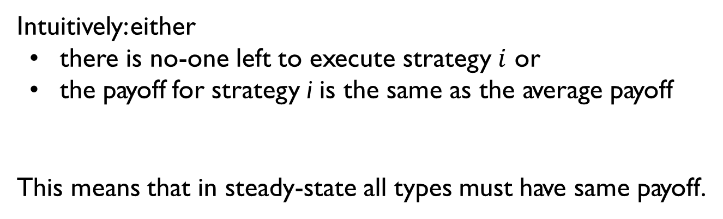
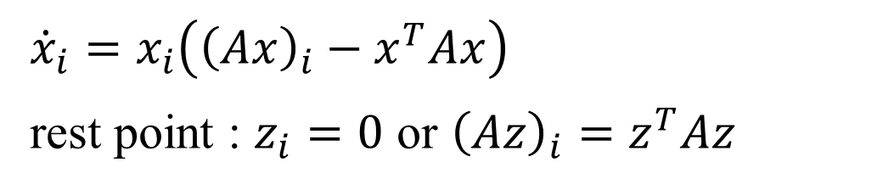
Replicator dynamics - Rest Points
${\dot{x}}_{i}=x_{i}\left({\left(Ax\right)}_{i}−x^{T}Ax\right)$
rest point : $z_{i}=0$ or ${\left(Az\right)}_{i}=z^{T}Az$
Intuitively: either
there is no-one left to execute strategy $i$ or
the payoff for strategy i is the same as the average payoff
This means that in steady-state all types must have same payoff.
FIT5226-S2-2024
41/59
Notes:
In replicator dynamics, rest points, also known as fixed points or equilibria, represent stable or steady-state configurations of the population where the frequencies of strategy types no longer change over time. Let's break down the key points:
The equation provided:
𝑥 ̇_𝑖 = 𝑥_𝑖 ((𝐴𝑥)_𝑖 − 𝑥^𝑇 𝐴𝑥)
describes how the frequency of strategy type i, denoted as x_i, changes over time. Now, let's discuss the rest points:
Rest Point 𝑧_i = 0: This represents a rest point where the frequency of strategy type i, denoted as z_i, becomes zero. In other words, there are no individuals left in the population who are executing strategy i.
(𝐴𝑧)_𝑖 = 𝑧^𝑇 𝐴𝑧: This condition means that the expected payoff for strategy type i when interacting with others in the population (𝐴𝑧)_𝑖 is equal to the mean or average payoff in the population, as represented by 𝑧^𝑇 𝐴𝑧.
Intuitively, these conditions mean:
Either there is no one left to execute strategy i: This condition occurs when the frequency of strategy i, z_i, becomes zero. In such cases, strategy i has effectively disappeared from the population.
Or the payoff for strategy i is the same as the average payoff: This condition occurs when the expected payoff for strategy type i (𝐴𝑧)_𝑖 is equal to the average payoff 𝑧^𝑇 𝐴𝑧. In this case, strategy i neither grows nor declines, as its payoff is in equilibrium with the average.
The key insight here is that at rest points, the frequencies of strategy types no longer change because either those strategies have disappeared from the population or their payoffs are in equilibrium with the population's average payoff. In steady-state, all strategy types must have the same payoff when interacting with the rest of the population. This reflects a balanced state where no strategy can unilaterally increase its frequency.

Slide 42
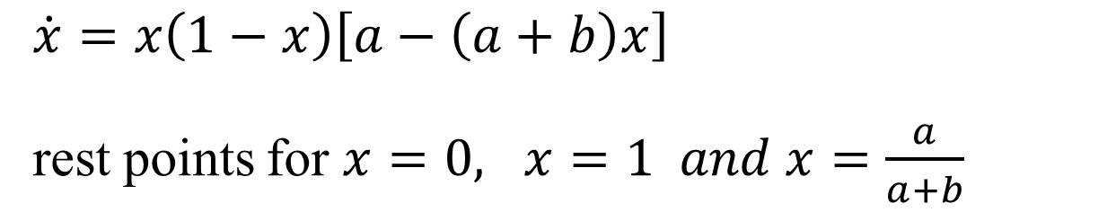

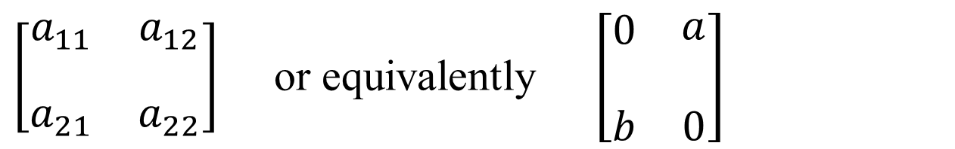
Replicator equation for n=2
$x_{1}=x, { x}_{2}=1−x$
$\left[\begin{matrix}\begin{aligned}a_{11} \\ \end{aligned} & \begin{aligned}a_{12} \\ \end{aligned} \\ a_{21} & a_{22}\end{matrix}\right]$ or equivalently $\left[\begin{matrix}\begin{aligned}0 \\ \end{aligned} & \begin{aligned}a \\ \end{aligned} \\ b & 0\end{matrix}\right]$
$b=a_{21}−a_{11}$
$\dot{x}=x\left(1−x\right)\left[a−\left(a+b\right)x\right]$
rest points for $x=0, x=1 and x=\frac{a}{a+b}$
(provided ab > 0)
FIT5226-S2-2024
42/59
Notes:
provides the replicator equation for a two-strategy (n=2) game with the given payoff matrix: ------------------- | 0 | a | ------------------- | b | 0 | ------------------- The replicator equation for this game, where strategy 1 is represented as 𝑥_1 and strategy 2 is represented as 𝑥_2, can be expressed as:
𝑥_1' = 𝑥_1(1 - 𝑥_1)(a - (a + b)𝑥_1)
This equation describes how the frequency 𝑥_1 changes over time. The rest points (equilibrium points) occur when 𝑥_1' = 0:
𝑥 = 0: When 𝑥_1 = 0, it means that the population consists entirely of strategy 2 (𝑥_2 = 1), and strategy 1 is extinct.
𝑥 = 1: When 𝑥_1 = 1, it means that the population consists entirely of strategy 1 (𝑥_2 = 0), and strategy 2 is extinct.
𝑥 = 𝑎/(𝑎 + 𝑏): At this rest point, both strategies coexist in the population, with 𝑥_1 being the fraction of individuals following strategy 1, and 𝑥_2 being the fraction following strategy 2. This equilibrium point represents a stable mixed strategy where both strategies are present in the population.
These rest points correspond to different evolutionary outcomes in the population. The first two points represent pure strategy outcomes where one strategy dominates, while the third point represents a stable mixed strategy outcome where both strategies coexist.

Slide 43
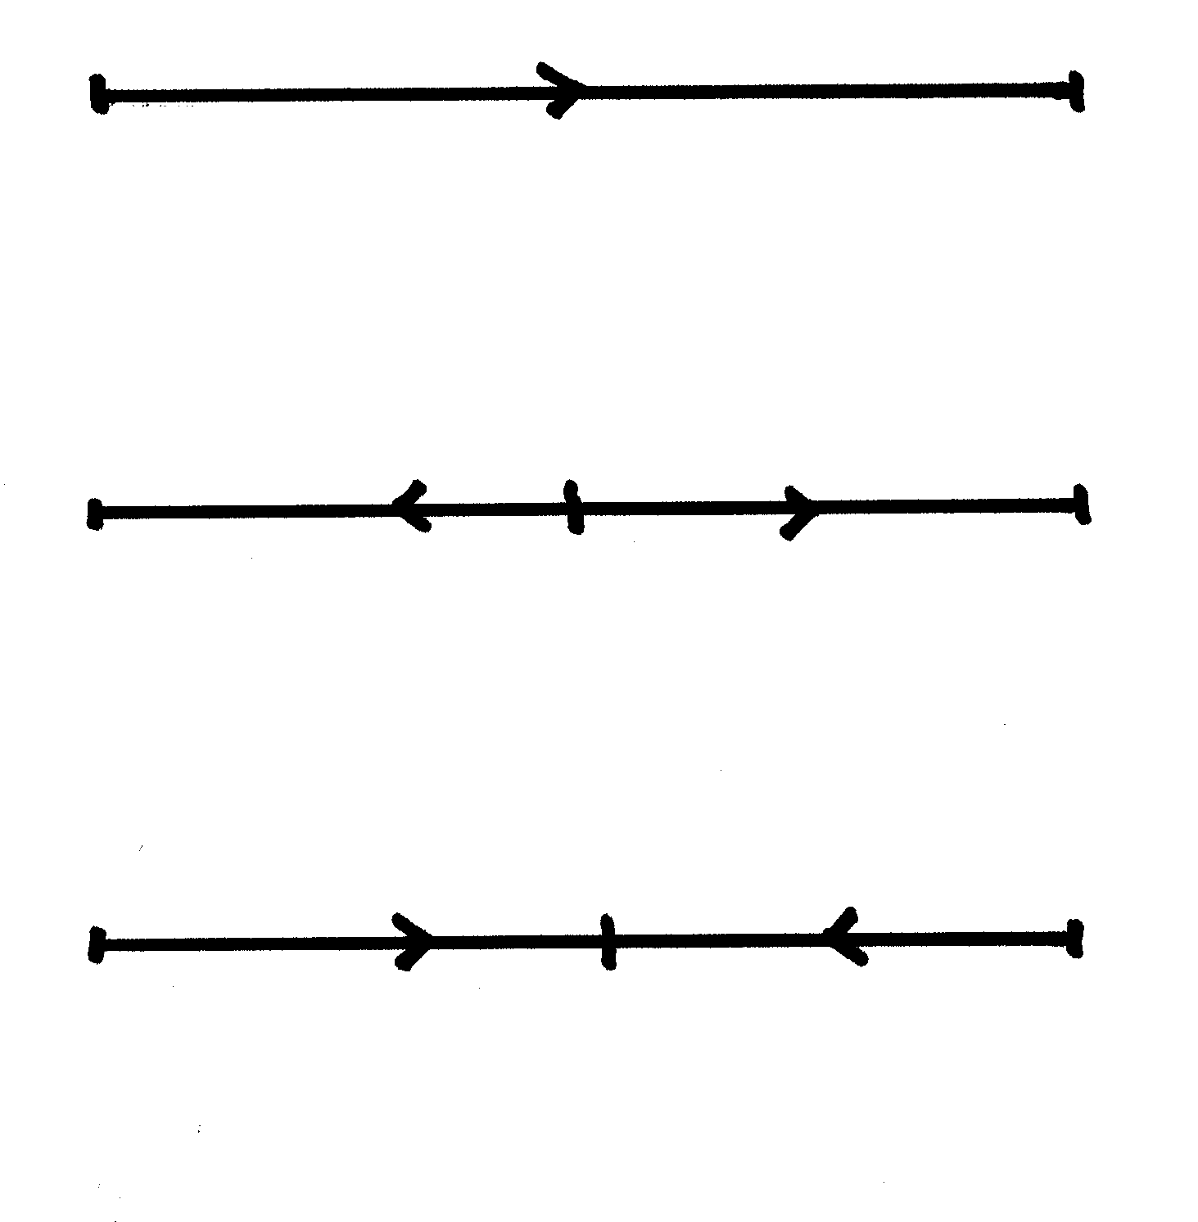
Replicator equations for n=2:
 Dominance
 Bistability
 stable coexistence
FIT5226-S2-2024
43/59
Notes:
Dominance: ------------>-------------
This sketch shows arrows pointing to the right, indicating unidirectional evolution towards a single strategy.
Interpretation: One strategy dominates the other. Regardless of the initial population composition, the population will evolve towards 100% of one dominant strategy.
Example: If strategy A always gives a higher payoff than strategy B, no matter the population mix, then strategy A dominates, and the population will evolve entirely towards strategy A.
Bistability: ------<----|---->------
Sketch: The arrows point away from the middle vertical bar, indicating that the middle point is unstable.
Interpretation: This situation represents an unstable equilibrium in the middle (the vertical bar), and the population evolves away from it. If the population starts on one side of the middle, it will eventually evolve toward one of the two stable equilibria (on either side of the middle).
Example: Think of this as a tipping point. If the population starts close to one strategy, it will evolve to adopt that strategy entirely, depending on where the initial population is located. The middle point (the bar) is unstable—if the population starts exactly there, it can evolve in either direction.
Stable coexistence: ------>----|----<------
Sketch: The arrows point towards the middle vertical bar, indicating a stable equilibrium at the middle.
Interpretation: This represents stable coexistence, where the population evolves towards a balance of both strategies. The middle point is stable, and regardless of where the population starts, it will move towards this point.
Example: In some evolutionary games (like Hawk-Dove), neither strategy dominates entirely, but a certain mix of both strategies leads to a stable equilibrium.
Summary of Diagrams:
Dominance: One strategy dominates, and the population evolves towards that single strategy.
Bistability: Two stable outcomes exist, and the population evolves away from the unstable middle point towards one of the stable equilibria, depending on the starting condition.
Stable Coexistence: The population evolves towards a balance of both strategies, with the middle point representing a stable equilibrium.
These diagrams summarize how the replicator dynamics guide the evolution of strategies over time.

Slide 44
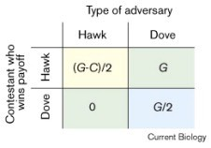

Self Study: Example coexistence: Hawk-Dove Game
Hawk : escalate until injury
Dove : display, run away if co - player escalates
G gain of contest, - C fitness cost, C > G
x → G / C
prevalenceof ritual contests
FIT5226-S2-2024
44/59
Notes:
In the Hawk-Dove game you've described, where Hawk and Dove are two competing strategies, and G represents the gain from winning a contest while C represents the fitness cost associated with getting injured during a contest (where C > G), the parameter x, as you've correctly stated, represents the prevalence of ritual contests.
Specifically, x = G / C represents the threshold prevalence value at which Hawk (escalating behavior) and Dove (ritual display and retreat) coexist in equilibrium. This means that when x = G / C, both strategies are equally prevalent in the population, and the expected payoffs for both strategies are equal.
To further clarify:
When x < G / C: Dove strategy becomes more prevalent because the cost of injury (C) is significantly greater than the benefit of winning (G). Dove's expected payoff (G/2) is higher than the expected payoff of Hawk (G-C)/2, leading to a prevalence of Dove.
When x > G / C: Hawk strategy becomes more prevalent because the benefit of winning (G) is significantly greater than the cost of injury (C). Hawk's expected payoff (G-C)/2 is higher than the expected payoff of Dove (G/2), leading to a prevalence of Hawk.
When x = G / C: Both Hawk and Dove coexist in equilibrium because their expected payoffs are equal, representing a prevalence of ritual contests where both strategies are present.
The parameter x = G / C captures the delicate balance between the benefits and costs associated with these two strategies, providing insights into the conditions under which different strategies can coexist in a population.

Slide 45
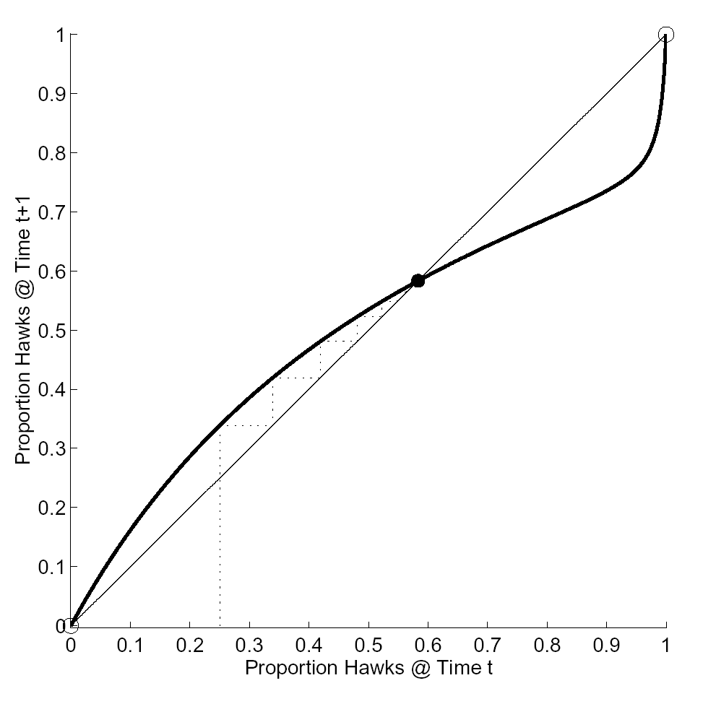
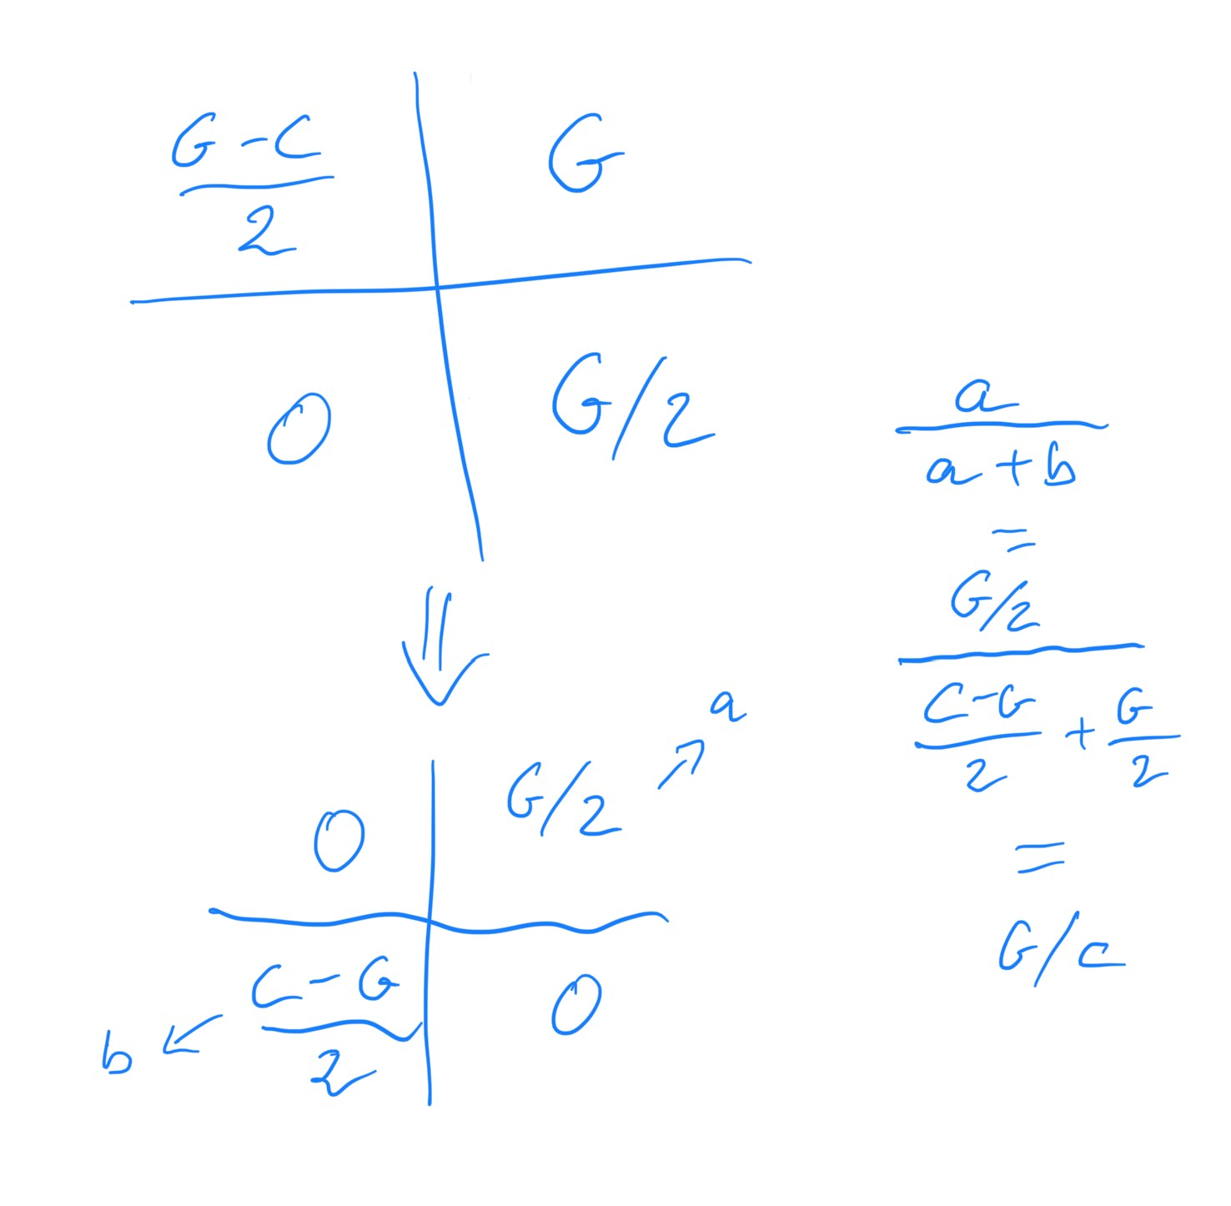
Self Study: Stable Polymorphic State
FIT5226-S2-2024
45/59

Slide 46


Self Study: Example dominance: Prisoner’s Dilemma
$$\left[\begin{matrix}\begin{aligned}10 \\ \end{aligned} & \begin{aligned}−5 \\ \end{aligned} \\ 15 & 0\end{matrix}\right]$$
or equivalently
$$\left[\begin{matrix}\begin{aligned}0 \\ \end{aligned} & \begin{aligned}−5 \\ \end{aligned} \\ 5 & 0\end{matrix}\right]$$
x → 0 (freq. of cooperators)
Homework: check this by simulating RD
FIT5226-S2-2024
46/59

Slide 47
Link to Reinforcement Learning
Cross-Learning provably exhibits
replicator dynamics.
[ in expectation and in the continuous time limit ]
This is non-trivial: we now have a simple model of individual learning (based on reinforcement) that will follow the same dynamics as social learning (based on imitation).
This means, it will reach Nash under the same conditions etc.
FIT5226-S2-2024
47/59
Notes:
The idea, where a simple model of individual learning based on reinforcement learning exhibits similar dynamics to social learning based on imitation, is interesting and has connections to game theory and evolutionary dynamics. Let's break down this concept further:
Cross-Learning: Cross-learning is a concept where individual learning, often based on reinforcement learning principles, can exhibit dynamics similar to those seen in social learning, which involves imitation or learning from others.
Replicator Dynamics: Replicator dynamics describe the evolution of strategies in a population, often used in the context of evolutionary game theory. These dynamics show how the frequencies of different strategies change over time.
Reaching Nash Equilibria: In some cases, both individual learning (reinforcement learning) and social learning (imitation) can lead to the convergence of strategies to Nash equilibria. This is significant because Nash equilibria represent stable points in strategic interactions where no player has an incentive to change their strategy unilaterally.
Conditions for Convergence: The conditions under which reinforcement learning or individual learning models converge to Nash equilibria can vary depending on the specifics of the learning algorithm and the nature of the game being played. Not all learning algorithms or games will lead to Nash equilibria.
Continuous Time Limit: The idea that these dynamics converge in the continuous time limit aligns with the concept of equilibrium analysis in continuous-time evolutionary game theory, where strategies change continuously.
In summary, the relationship between reinforcement learning and replicator dynamics, and their connection to Nash equilibria, is an active area of research. Researchers are exploring how different learning models, including reinforcement learning, can be used to analyze and understand the emergence of equilibria in various game-theoretical and social learning contexts. The convergence to Nash equilibria under certain conditions is a fascinating aspect of this research, as it highlights the connection between individual and social learning dynamics in strategic interactions.

Slide 48
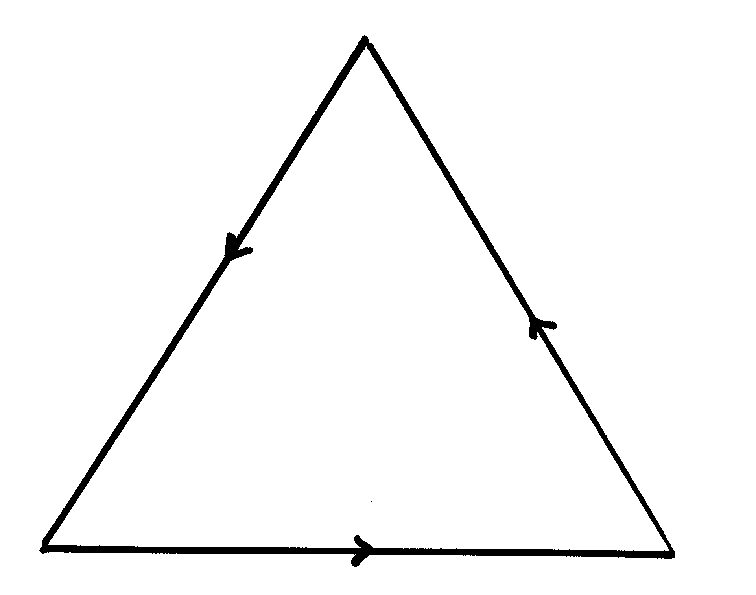
Replicator equations for n=3:
Possibility of
heteroclinic cycles (rock-scissors-paper)
FIT5226-S2-2024
48/59
Notes:
In a game with n=3 strategies, you can describe the replicator dynamics using a system of three first-order differential equations. This is often used to model scenarios like the "rock-paper-scissors" game. Here's a general form of the replicator equations for n=3:
Let x_1, x_2, and x_3 represent the proportions or frequencies of strategies 1, 2, and 3 in the population, respectively.
The replicator equations for this case can be expressed as follows:
For strategy 1 (x_1):
x_1' = x_1 * [f_1(x_1, x_2, x_3) - Φ]
For strategy 2 (x_2):
x_2' = x_2 * [f_2(x_1, x_2, x_3) - Φ]
For strategy 3 (x_3):
x_3' = x_3 * [f_3(x_1, x_2, x_3) - Φ]
In these equations:
x_1', x_2', and x_3' represent the rates of change of the frequencies of strategies 1, 2, and 3, respectively.
f_1(x_1, x_2, x_3), f_2(x_1, x_2, x_3), and f_3(x_1, x_2, x_3) are the fitness functions associated with each strategy. These functions determine how the fitness of each strategy depends on the frequencies of all three strategies in the population.
Φ represents the average fitness of the population, which is calculated as a weighted average of the fitness of all three strategies based on their frequencies.
The existence of heteroclinic cycles, as you mentioned in the context of "rock-scissors-paper" dynamics, is indeed possible in such systems. In a heteroclinic cycle, the population proportions cyclically change over time, and no single strategy dominates permanently.
For "rock-scissors-paper" dynamics, the fitness functions are typically set up so that each strategy has an advantage over one strategy while being vulnerable to another, creating a cyclical pattern where no strategy can dominate. The exact form of the fitness functions (f_1, f_2, f_3) would depend on the specific rules of the game or the interactions between the strategies.
Heteroclinic cycles are a fascinating phenomenon in evolutionary game theory and can lead to the coexistence and cycling of different strategies in a population. The exact dynamics of these cycles would depend on the specific values and forms of the fitness functions.

Slide 49
Rock-Scissors-Paper in nature
Uta stansburiana (lizards) males: 3 morphs (inheritable)
monogamous, guards female
polygamous, guards harem (inefficiently)
loose males, sneaky matings
FIT5226-S2-2024
49/59
Notes:
The concept of "Rock-Scissors-Paper" dynamics, often referred to as cyclic dominance or the rock-paper-scissors game, can indeed be observed in various natural systems, including animal behavior. The example you provided involving Uta stansburiana lizards is an interesting case where different male morphs exhibit strategies reminiscent of this dynamic.
In the context of Uta stansburiana lizards:
Monogamous, Guards Female: This strategy can be seen as analogous to "Rock" in the rock-paper-scissors game. The monogamous males adopt a strategy of guarding a single female, which can be effective when there's limited competition for mates.
Polygamous, Guards Harem (Inefficiently): This strategy might be akin to "Scissors." These males attempt to monopolize a harem of females but may do so inefficiently, as they may face challenges from other males or not be as successful in maintaining a larger group of females.
Loose Males, Sneaky Matings: This strategy corresponds to "Paper" in the analogy. These males employ a sneaky mating strategy, which might involve attempting to mate with females without investing in guarding behavior.
In natural populations, the dynamics between these male morphs can lead to cyclic dominance. For example:
Monogamous males may be successful when they can effectively guard a female.
Polygamous males may have an advantage over monogamous males when there are multiple females to compete for.
Loose males may exploit opportunities when neither of the other strategies is dominant, as they can attempt sneaky matings.
This can lead to a cyclical pattern where the success of one strategy leads to the success of another, creating a dynamic equilibrium where no single male morph dominates the population for an extended period.
These kinds of cyclic dynamics can be driven by complex interactions, including frequency-dependent selection, and are intriguing examples of how different strategies can coexist in nature through a form of "rock-paper-scissors" competition.

Slide 50
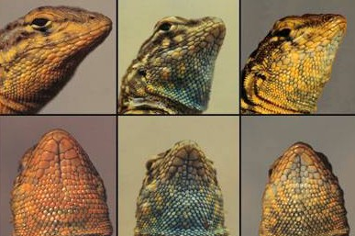

Male morphs in side-blotched lizard
www.monash.edu.au
orange
blue
yellow
50
Sinervo & Lively Nature 1996

Slide 51
Evolutionary Game
Orange throated males: loosely defend large territory with several females
Yellow striped males: mimic females, can sneak into large territories
Blue throated males: firmly defend small territory with one female, not fooled by yellows
Evolutionary game: blue beats yellow, yellow beats orange, orange beats blue
results in 5 year cycles
Large Territory Holders
Defenders
Sneakers
FIT5226-S2-2024
51/59
Notes:
The scenario involving orange-throated, yellow-striped, and blue-throated males in an evolutionary game represents a fascinating example of cyclic dominance or rock-paper-scissors dynamics in nature. This type of ecological interaction can lead to cyclical population dynamics and is often observed in various animal species.
In this context:
Blue-throated males are the dominant strategy, as they can successfully defend a small territory with one female.
Yellow-striped males mimic females and can sneak into the territories of blue-throated males, effectively outcompeting them.
Orange-throated males loosely defend large territories with multiple females, and their strategy prevails against the yellow-striped males, as they can overwhelm them with their larger territories and female numbers.
The cyclic dominance you've described, where blue beats yellow, yellow beats orange, and orange beats blue, can result in cyclical population dynamics, often referred to as "rock-paper-scissors" dynamics. In this case, the population proportions of these male types can oscillate over time, creating a repeating cycle of dominance.
For example, when blue-throated males dominate, the population of yellow-striped males can increase as they mimic females and infiltrate blue territories. As the yellow-striped males become more prevalent, they may face competition from the orange-throated males who can exploit their larger territories. When orange-throated males dominate, blue-throated males may gain an advantage by outcompeting them for territory.
This cyclical pattern can lead to fluctuations in the frequencies of these male morphs over a period of time, resulting in approximately 5-year cycles, as you mentioned. Such dynamics are often influenced by various ecological factors, including resource availability, predation pressure, and the fitness of each strategy under different conditions.
These rock-paper-scissors dynamics provide a captivating example of how different strategies can coexist and cycle in populations, contributing to the diversity and stability of ecosystems.

Slide 52
“Folk theorem” of evolutionary game theory
➡ if the dynamics converges, it converges to NE
➡ strict NE are attractors
➡ stable rest points are NE
The replicator equation and other game dynamics. Ross Cressman and Yi Tao, PNAS 111:10810-10817
FIT5226-S2-2024
52/59
Notes:
The "folk theorem" of evolutionary game theory is an informal term used to describe various results and insights regarding the relationship between evolutionary dynamics and Nash Equilibrium (NE) in repeated games. The folk theorem encompasses several key points, as you've mentioned:
Convergence to Nash Equilibrium (NE): In many repeated games, if the evolutionary dynamics converge, they tend to converge to a Nash Equilibrium. This means that over time, as individuals adapt their strategies based on the outcomes of repeated interactions, the population often reaches a state where no player has an incentive to unilaterally deviate from their strategy because they are all playing a best response to the strategies of others.
Strict NE Are Attractors: In the context of evolutionary dynamics, strict Nash Equilibria (those where no player can improve their payoff by a small unilateral change) are often considered attractors. This means that if the population starts close to a strict Nash Equilibrium, the dynamics tend to stabilize around that equilibrium over time. Small deviations from the strict NE are typically corrected by the dynamics.
Stable Rest Points Are NE: Stable rest points in evolutionary dynamics are often Nash Equilibria. When a rest point (an equilibrium where the frequencies of strategies no longer change) is stable, it implies that it is also a Nash Equilibrium. This connection reinforces the idea that the dynamics naturally lead to equilibrium states.
These insights are important in understanding the long-term behavior of populations in repeated games. They highlight the relationship between evolutionary dynamics, stability, and the emergence of Nash Equilibria as stable outcomes in strategic interactions over time. However, it's worth noting that the precise conditions and outcomes can vary depending on the specifics of the game, the nature of interactions, and the adaptation rules used in the evolutionary dynamics.

Slide 53

Adaptive Dynamics: Snowdrift Example
Freeloaders
FIT5226-S2-2024
53/59
Notes:
Adaptive dynamics is a theoretical framework in evolutionary biology and game theory that focuses on how small, heritable mutations in traits or strategies can lead to evolutionary change over time. It helps to explain the long-term dynamics of populations and how different strategies or traits can persist or replace each other. Let's explore the concept of adaptive dynamics using the "Snowdrift Game" as an example.
The Snowdrift Game, also known as the "Stag Hunt" or "Chicken" game, is a classic game in game theory and evolutionary biology that illustrates cooperation and conflict. In this game, two players have two possible strategies: "hunt" or "wait." The payoffs for each player depend on the joint strategy they choose:
If both players choose "hunt," they can catch a stag (a high payoff), but they must cooperate to do so.
If one player chooses "hunt" while the other chooses "wait," the "waiter" receives nothing, and the "hunter" gets a moderate payoff (from catching a hare, for example).
If both players choose "wait," they get a low payoff because they wasted their time.
The Snowdrift Game captures a dilemma where cooperation (both hunting) can lead to the best outcome for both players, but defection (one hunting while the other waits) can lead to a better outcome for an individual.
Now, let's apply adaptive dynamics to this game:
Trait Space: In the Snowdrift Game, the trait space represents the proportion of individuals in the population playing each strategy (e.g., the fraction of "hunters" and "waiters").
Mutations: Adaptive dynamics considers small, heritable mutations that can change the proportion of strategies in the population. For example, a mutation might cause a slight increase in the number of "hunters."
Fitness Functions: The fitness functions describe how the payoffs (fitness) of individuals depend on the proportion of strategies in the population. In the Snowdrift Game, the fitness of each strategy depends on the interactions with others and the frequency of each strategy in the population.
Evolutionary Dynamics: Adaptive dynamics models how the proportion of strategies evolves over time due to the fitness of each strategy relative to others. It examines how mutations that increase or decrease the proportion of a strategy can spread through the population.
In the Snowdrift Game, adaptive dynamics may reveal that the population can exhibit mixed strategies, where both "hunters" and "waiters" coexist in certain proportions. The dynamics would depend on the specific payoffs, mutation rates, and initial conditions. Adaptive dynamics can help us understand how these proportions change over generations and whether stable equilibria emerge, such as a stable mix of both strategies.
Adaptive dynamics provides a powerful framework for exploring the evolution of strategies in complex social interactions and can be applied to various biological and social systems to understand how cooperation and conflict evolve over time.

Slide 54
Snowdrift Games
Similar to prisoner’s dilemma
but here with continuous trait value (investment in the task)
and continuous payoff
Π(X, Y ) = B(X + Y ) − C(X)
collective benefit but individual cost
we can’t handle continuous traits with replicator!
FIT5226-S2-2024
54/59
Notes:
The Snowdrift Game is similar to the Prisoner's Dilemma in that it represents a situation where there is a tension between individual and collective interests. In the Snowdrift Game, the key features include continuous trait values (investment in the task), continuous payoffs, and the presence of a collective benefit but individual cost. These features make it different from the traditional replicator dynamics, which are typically used for discrete strategies.
In the Snowdrift Game, players face the following trade-off:
Investing more in the task (higher trait value) contributes to the collective benefit, which benefits all players.
However, the cost of the individual investment is borne solely by the player making the investment.
The payoffs are often represented by the following equation:
Π(X, Y) = B(X + Y) - C(X)
Where:
Π(X, Y) represents the payoff for a player investing X in the task while the opponent invests Y.
B represents the collective benefit derived from the total investment (X + Y).
C represents the cost of individual investment.
One approach to study the dynamics of the Snowdrift Game is to use evolutionary game theory techniques that can handle continuous traits and payoffs. These techniques may involve mathematical models such as adaptive dynamics, which consider how the continuous trait values change over time due to selection and mutation.
In adaptive dynamics, the focus is on studying the evolution of continuous traits, and the analysis considers how small mutations in trait values affect an individual's fitness and the population's trait distribution. This approach can help explore how different investment levels (continuous trait values) can evolve over time and whether stable strategies or trait distributions emerge in the population.
Overall, while traditional replicator dynamics are designed for discrete strategies, evolutionary game theory provides tools like adaptive dynamics to analyze and understand the dynamics of continuous traits and payoffs in games like the Snowdrift Game.

Slide 55
Snowdrift Game Implementation
def oneRound():
global population
opponents = np.array(population) np.random.shuffle(opponents) allGames=np.array([population, opponents]).T allPayoffs=map(payoffGame,allGames) parents=np.random.choice(population,popSize,
replace=True,p=allPayoffs/np.sum(allPayoffs)) population=np.array(map(mutateIf,parents))
def payoffGame(G):
return benefit(G[0]+G[1])-cost(G[0])
FIT5226-S2-2024
55/59
Notes:
A code snippet for implementing the Snowdrift Game using a Python function. Here's a complete version of your code: -------------------------------------------------------------------------------------- import numpy as np
# Define parameters
popSize = 100
mutationRate = 0.01
# Define the benefit and cost functions
def benefit(total_investment):
return total_investment # Modify this as needed
def cost(individual_investment):
return individual_investment # Modify this as needed
# Define the mutation function
def mutate(individual):
if np.random.rand() < mutationRate:
return np.random.rand() # Mutate to a random value
else:
return individual
# Initialize the population with random trait values
population = np.random.rand(popSize)
# Define the payoff function
def payoffGame(G):
return benefit(G[0] + G[1]) - cost(G[0])
# One round of the Snowdrift Game
def oneRound():
global population
opponents = np.array(population)
np.random.shuffle(opponents)
allGames = np.array([population, opponents]).T
allPayoffs = list(map(payoffGame, allGames))
parents = np.random.choice(population, popSize, replace=True, p=allPayoffs/np.sum(allPayoffs))
population = np.array(list(map(mutate, parents)))
# Example usage:
for _ in range(10):
oneRound()
print("Population after one round:", population)
------------------------------------------------------------------------------ Here's what the code contains:
Defined parameters like popSize and mutationRate explicitly.
Modified the benefit and cost functions to return values based on the trait values.
Added a mutate function that randomly mutates trait values based on the mutation rate.
Initialized the population with random trait values.
Modified the payoffGame function to work with the array G.
In the oneRound function, I've corrected the code for calculating allPayoffs and parents, and I've applied the mutate function to the parents.
Provided an example of how to run multiple rounds of the Snowdrift Game.

Slide 56
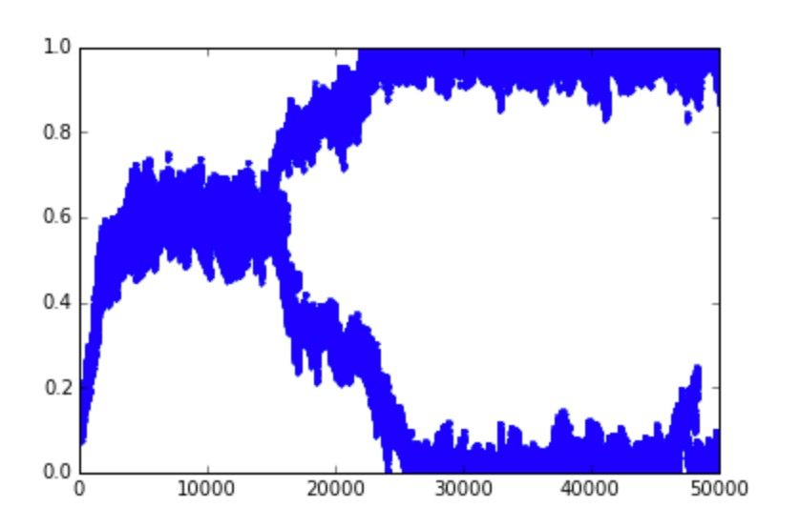
Snowdrift Game Simulation
Freeloaders
FIT5226-S2-2024
56/59
Notes:
In various social and cooperative contexts, a "freeloader" refers to an individual who benefits from the efforts, resources, or contributions of a group or community without making an equitable or proportionate contribution in return. Freeloaders are often seen as individuals who take advantage of collective efforts or resources without putting in their fair share of work or resources.

Slide 57
Adaptive dynamics framework
can handle continuous traits (continuous strategy space) but:
Population is assumed to be homogeneous (monomorphic): all players adopt same strategy
•
•
Mutation generates variant strategies very close to the resident strategy and is rare
If a mutant beats the resident players it takes over otherwise it is rejected
•
FIT5226-S2-2024
57
57/59
Notes:
The adaptive dynamics framework is indeed a valuable tool in evolutionary biology and game theory for studying the evolution of continuous traits or strategies within a population. As you've described, it has some key characteristics and assumptions:
Continuous Traits: Adaptive dynamics can handle continuous traits, which means it's suitable for scenarios where individuals possess a wide range of trait values, and small, heritable mutations can lead to changes in these continuous traits.
Homogeneous Population: In adaptive dynamics, the focus is often on a homogeneous population, meaning that all individuals in the population have the same strategy or trait value. This simplifies the analysis and allows for the study of how a single trait evolves over time.
Rare Mutations: Adaptive dynamics assumes that mutations are rare events. Mutations are typically considered to be small changes in the trait value, leading to offspring that are very similar to their parents but with slight variations. These mutations can be thought of as small, incremental changes in the trait.
Fitness-Based Selection: The central concept in adaptive dynamics is the comparison of the fitness (reproductive success) of a mutant trait with the fitness of the resident trait. If a mutant trait provides a higher fitness (in a specific ecological context), it can invade and replace the resident trait over time. Otherwise, it is rejected, and the resident trait remains stable.
Adaptive dynamics is often used to study evolutionary scenarios where small changes in trait values can lead to significant evolutionary shifts over long periods. Researchers use mathematical models and simulations to analyze how the trait distribution in a population changes in response to mutation and selection.
This framework is particularly valuable for understanding the evolution of traits in ecological and evolutionary contexts, such as the evolution of morphological features, behavioral strategies, or life-history traits, under different environmental and competitive conditions.
It's important to note that while adaptive dynamics provides valuable insights, it is a simplification of the complex evolutionary processes that occur in real populations, which often involve multiple traits, interactions, and stochastic factors. Nonetheless, it offers a powerful approach for studying how continuous traits evolve in homogeneous populations subject to rare mutations and fitness-based selection.

Slide 58
Self Study: Some other Learning & Revision Protocols
Pairwise Comparison / Smith Dynamics
revising agents choose a candidate strategy at random, switching to it with positive probability if and only if its payoff is higher than the agent’s current strategy.
Pairwise comparison induces Smith Dynamics, which is Nash-stationary: the set of rest points is identical to the Nash equilibria
(Sampling) Best Response Dynamics
revising agents choose a set of opponents at random and switch to a best response strategy for these opponents.
FIT5226-S2-2024
58/59

Slide 59
Take home lessons 1/2
•
Evolutionary Game Theory is a useful tool for describing the learning of a group of agents. While it was originally designed to describe evolutionary processes it can be reinterpreted as describing learning by switching the timescales.
•
It describes the development of strategies in a large population, typically in symmetric games and of interchangeable agents that all have the same action set.
•
It addresses questions such as “what strategies can survive in a population?”; “can different strategies co-exist?” etc.
•
EGT introduces a new outcome concept: the Evolutionary Stable Strategy (ESS). A strategy is evolutionarily stable if it cannot be displaced by small mutations in a population.
strict NE ⊂ ESS ⊂ NE
Every 2-player 2-strategy symmetric game has an ESS.
•
•
Replicator dynamics describes how the proportions of different strategies in a population develop under such social learning (agents learning from each other). This can also be seen as evolutionary selection.
•
Cross-learning is one of the simplest forms of reinforcement learning. It describes individual learning from experience. In the continuous-time limit and in expectation it converges to the same outcome as replicator dynamics.

Slide 60
Take home lessons 2/2
•
Replicator dynamics can only describe agents with discrete action sets. Other (more complex) formalism for continuous action sets exist (e.g. adaptive dynamics).
•
In replicator dynamics, agents modify their strategies according to a so-called revision protocol. The most common revision protocol is imitation dynamics, in which agents copy strategies from each others with a probability that depends on the success of these strategies.
•
Since agents only copy strategies, replicator dynamics (without mutation) can never produce a new strategy. It only describes how proportions of existing strategies grow and shrink.
•
Other protocols are possible (e.g. best response, pairwise comparison) and many result in very similar dynamics.
Replicator dynamics can be described by the ODE system x·_{i} = x_{i}((Ax)_{i} − x^{T} Ax)
It can also be analysed using agent-based simulation.
•
•
•
Under imitation dynamics, replicator dynamics converges on Nash Equilibria (“Folk Theorem”).
•
In a 2-strategy game only three outcomes are possible: either one of the strategies dominates or there is a point of stable coexistence. If there are more than 2-strategies, the dynamics becomes far more complex (e.g. cycling is possible).

